Slide 1
Commemoration of The reformation Resource 1
500 Years of change
1

Slide 2
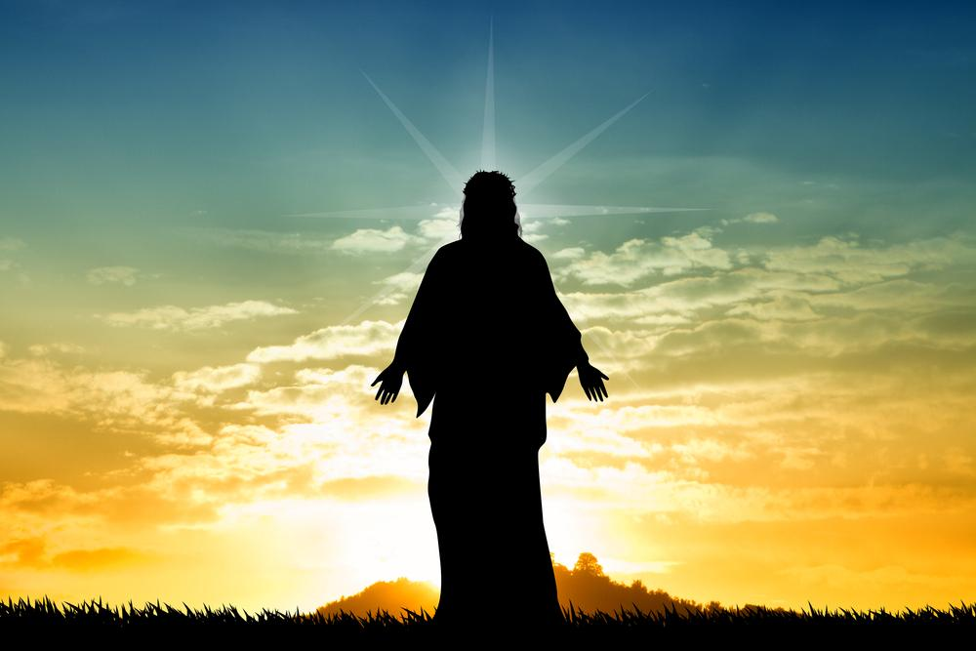
The Catholic Church in the First Century
After the Resurrection of Jesus Christ his followers came to be known as Christians.
The Church they formed was called “catholic” - meaning
‘universal’ –
for the whole world.
2

Slide 3
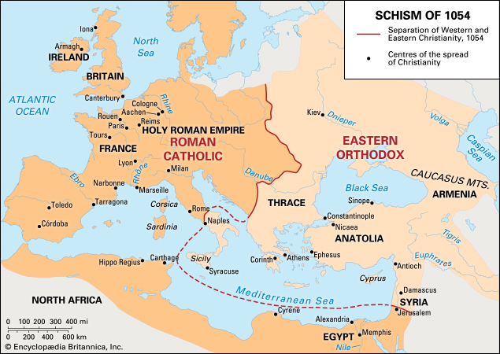
The Catholic Church Through the Ages 1
From the beginning of the Church (the first century) up until the Middle Ages (the 16th century) in the Western Empire, if people called themselves ‘Christians’, they were Roman Catholic.
3

Slide 4
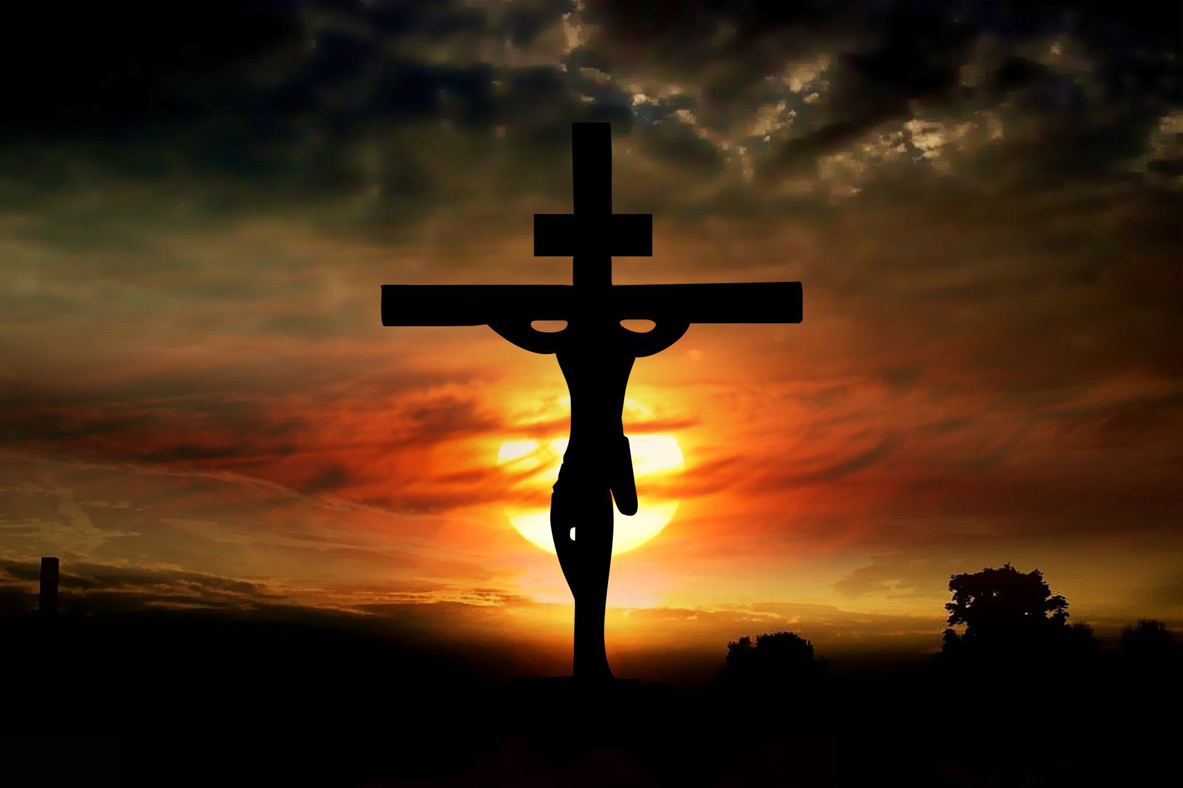
The Catholic Church Through the Ages 2
Christians, over the centuries, tried to remain faithful to the teachings of Jesus, following as best they could the teachings of their priests, bishops and the Pope………
BUT…….
4

Slide 5
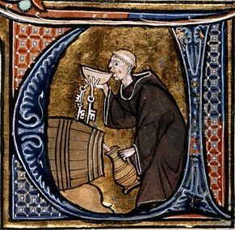
The Catholic Church in the Middle Ages 1
Over the years, many good Christians spoke up about some of the Church leaders and called for changes.
But a few of the leaders were rich and powerful and did not want to change.
Something
needed to be done
because….
5

Slide 6
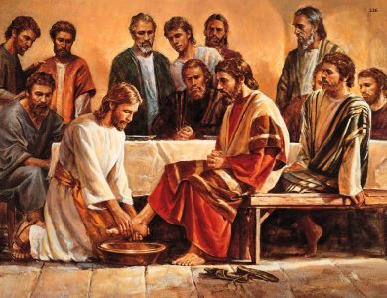
The Catholic Church in the Middle Ages 2
By the late Middle Ages, some priests, bishops and even some Popes weren’t following Jesus’ teachings.
Some were greedy……………
some were lazy …….
some were selfish…….
some were cheats……
some were ignorant……
some hurtful to others…….
6

Slide 7
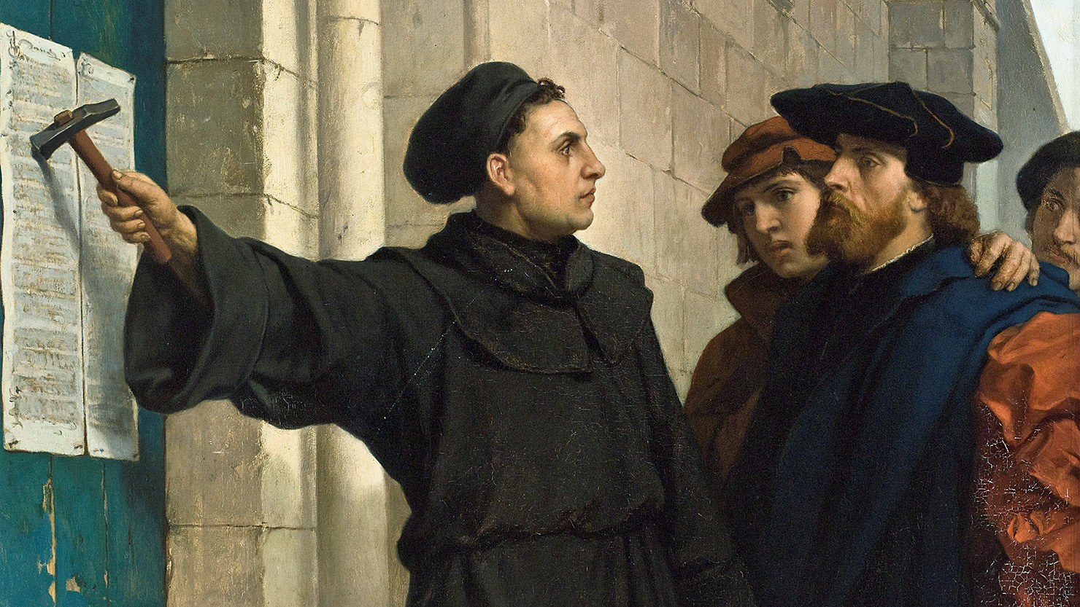
The Catholic Church and The Reformation 1
Then 500 years ago in October 1517 a German Catholic monk named Martin Luther arrived at the city church in Wittenberg and nailed to the door a list of 95 points. He wanted to discuss – his ‘95 Theses’
This action began what would
become known as the
Protestant Reformation
7

Slide 8
The Catholic Church and The Reformation 2
The main reason for Luther’s protests was the selling of indulgences
The Church taught that you could gain an indulgence (time off in Purgatory) if you did special works, or said special prayers, or gave money to the Church for special purposes
In Luther’s time abuses had crept in - indulgences were being sold to make money for the rebuilding of St Peter’s Basilica in Rome
Some Bishops were keeping the money for themselves
8

Slide 9
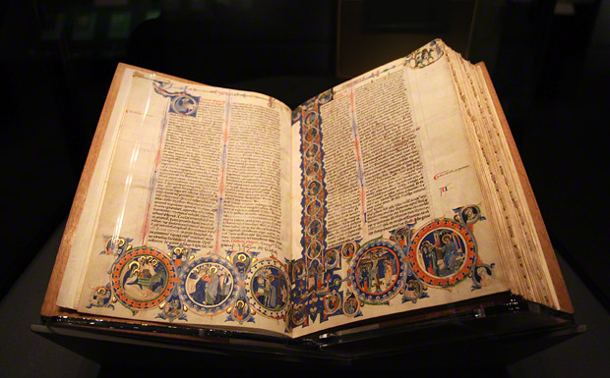
Martin Luther - Lutherans
Luther also stated that the Bible was the only source of revealed knowledge from God
Many people read Luther’s 95 Theses and joined in the protest for changes in the Church
Those who followed Luther’s teachings were called Lutherans
Luther was excommunicated from the Church by the Pope in 1521 because of his teachings
9

Slide 10
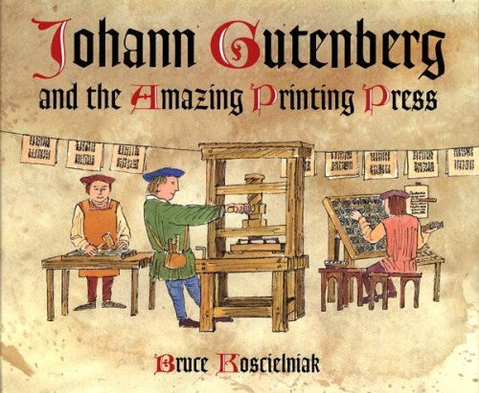
The Spread of the Reformation
Other people began to preach their versions of how the Christian Church should be run
These teachings spread quickly throughout Europe.
What new invention had occurred in the 15th century (c 1440) that helped spread these messages?
The invention of the
Printing Press
10

Slide 11
The Catholic Church - The Catholic Counter Reformation
Before all this happened, Catholic Reformers in the Middle Ages had been trying to bring about reforms in the Church by holding Councils
After Luther, the Council of Trent (in Italy) was called in 1545, bringing together heads of the Church
They met to: consider the questions of the Reformers reform certain aspects of the Church clarify the doctrines of the Church
11

Slide 12
The Reformation – New Christian churches
Over time, Reformists preaching their ideas started up many new Protestant churches
In the past 500 years many people have joined these new ways of being Christian

Slide 13
The Catholic Counter Reformation
The Council of Trent began what became known as the Catholic or Counter Reformation
During this Counter Reformation many changes were made to the way the Catholic Church was organised
The Catholic Counter Reformation ended at the close of the Thirty Years’ War in 1648
13

Slide 14
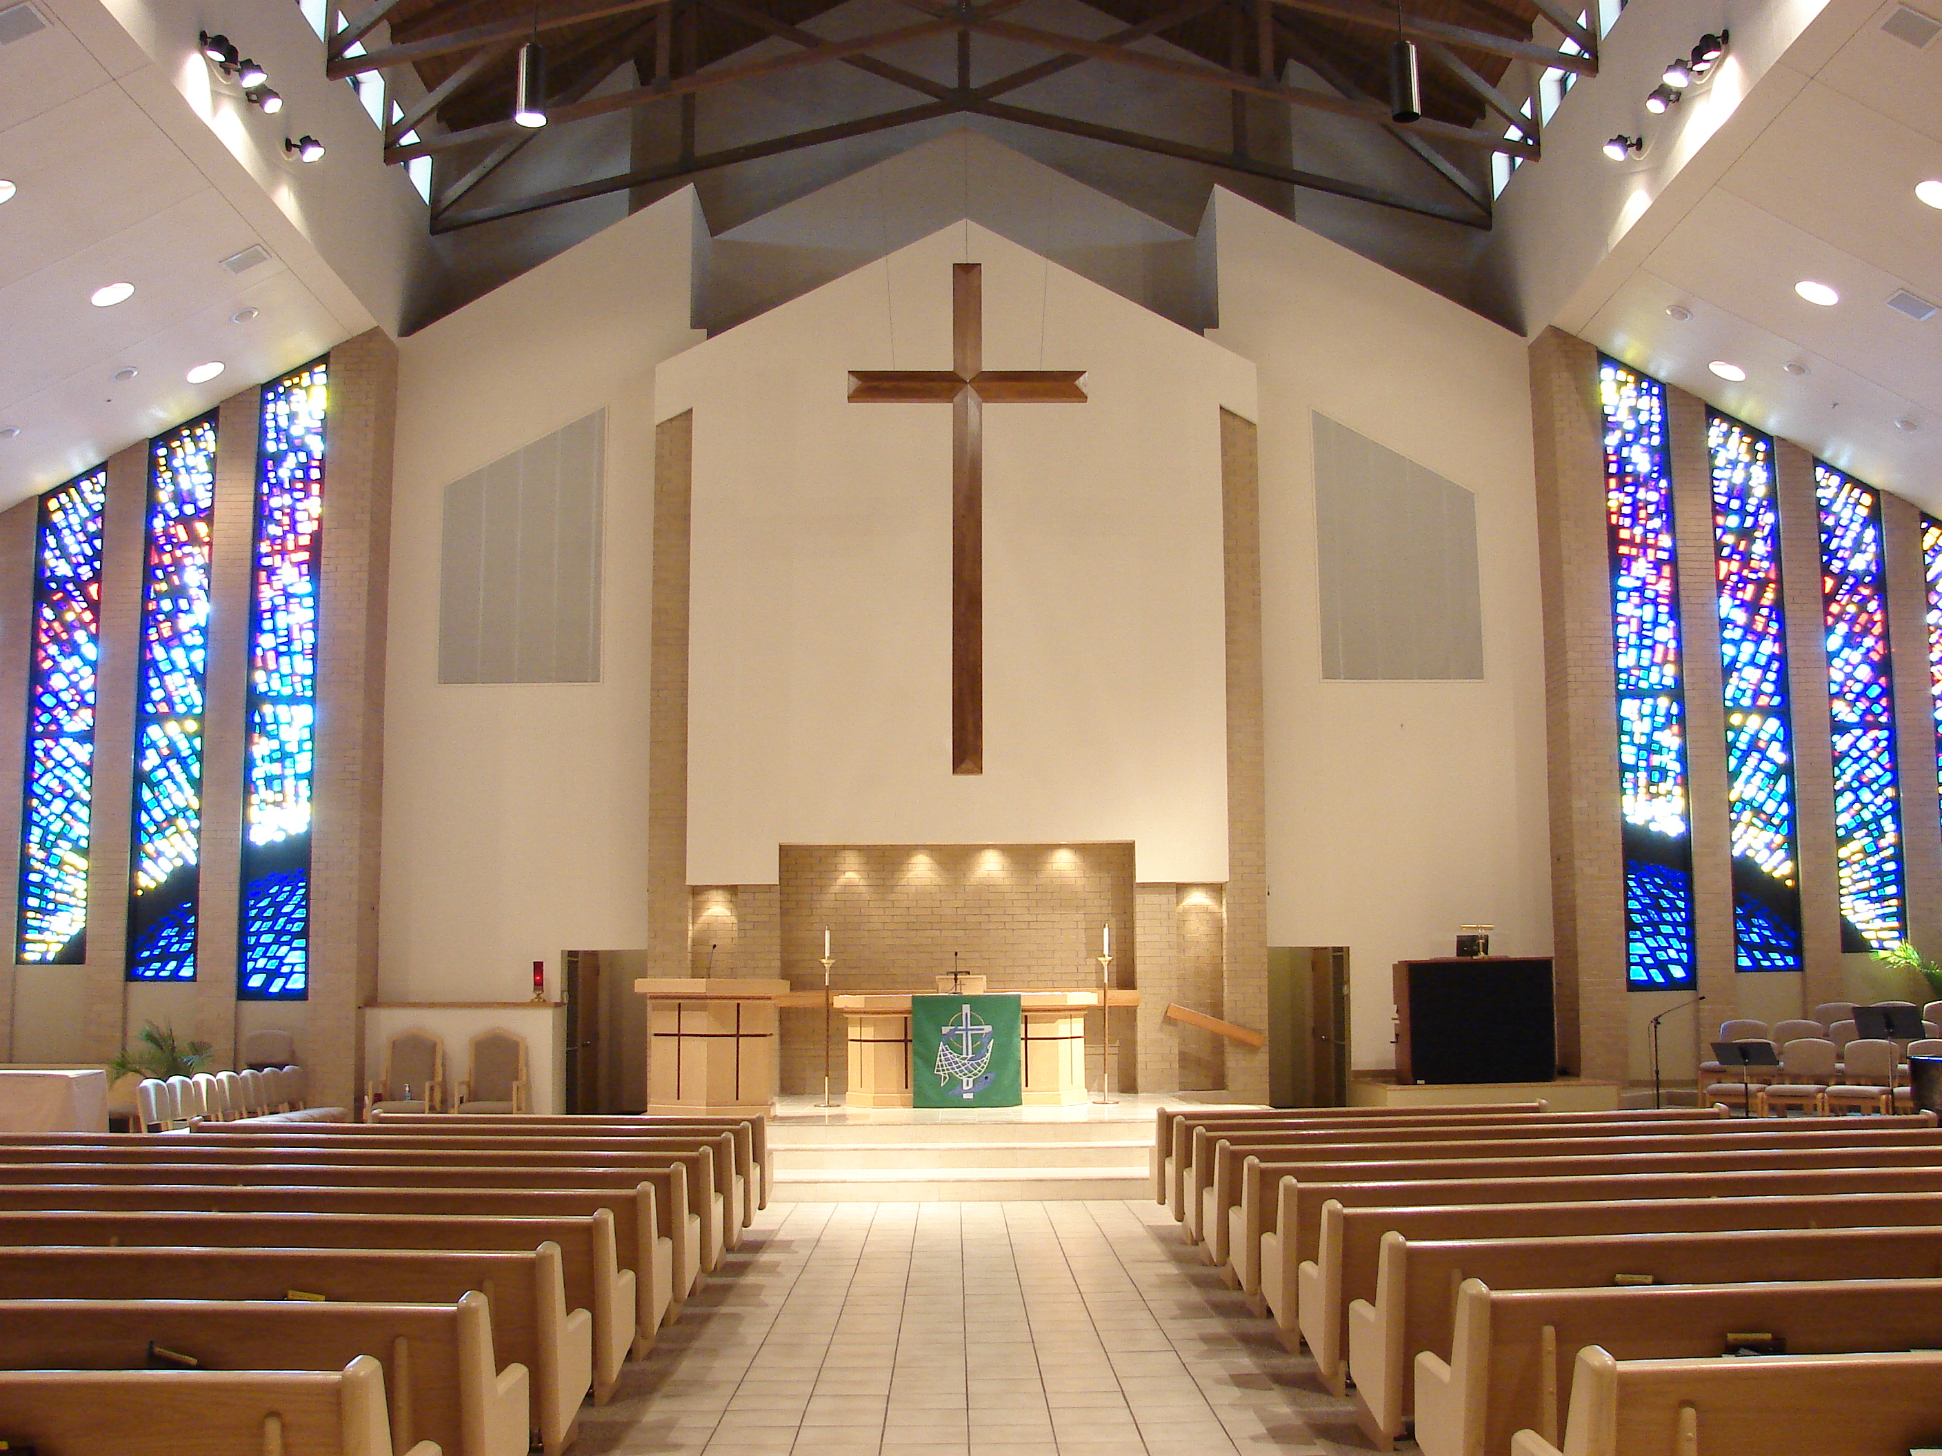
THAT THEY MAY ALL BE ONE
For the past fifty years the Catholic Church and the Lutheran Church have been working and talking together to overcome their differences and create a unity in Christ
We realise that there is more that unites us than divides us
Lutheran Church
I ask …..on behalf of all those who believe in me….. that they may all be one. John 17:20

Slide 15
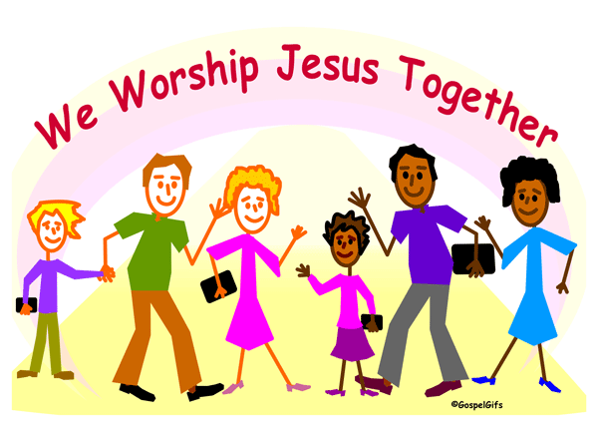
SEE HOW THEY LOVE ONE ANOTHER
People watching the early Christians said, ‘See how they love one another!’
This is what we pray will happen again with all Christians loving one another and being able to worship together.

Slide 16
Prayer for Christian unity
Let us pray for the unity of Christians
Lord Jesus Christ, at your Last Supper you prayed to the Father that all should be one. Bring down your Holy Spirit upon all of us, your Christian followers, to lead us that we may serve you in unity.
Strengthen our faith in you and help us to love one another as you love us.
16

Slide 17
Prayer for Christian unity
We pray that God, our Creator, will strengthen us, Jesus, our gracious Saviour will guide us, and that the love of the Holy Spirit will remain in our hearts, working through us, so that all Christians may grow in understanding and peace.
We ask this prayer in the name of Jesus, our Lord.
Amen.
17

