Slide 1
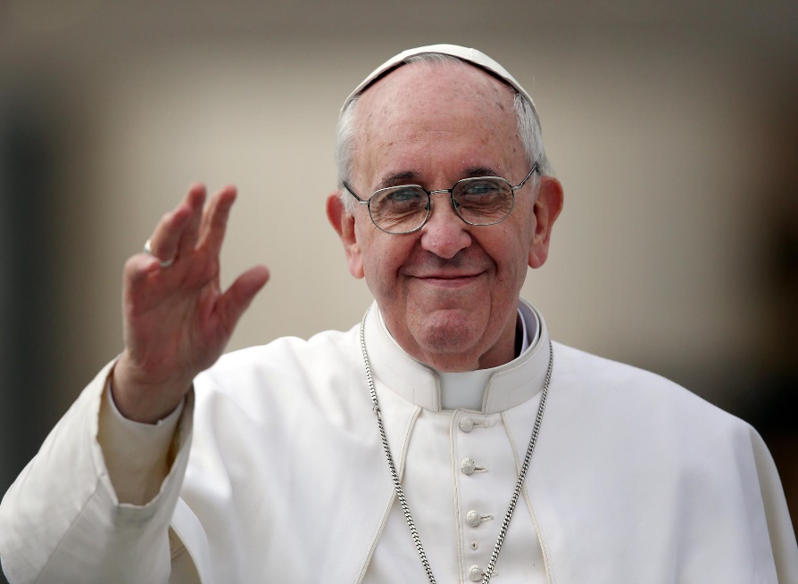
Laudato Si’
Praise be to you, My Lord
Parish Resource

Slide 2
Laudato Si’ - an Encyclical
An encyclical or teaching document, is a letter that the Pope circulates to the Church
Laudato Si’ was released in June 2015
it is a Catholic Social Teaching letter
a ‘social’ encyclical means it applies traditional, moral teachings of the Church to the social and economic challenges of the current times

Slide 3
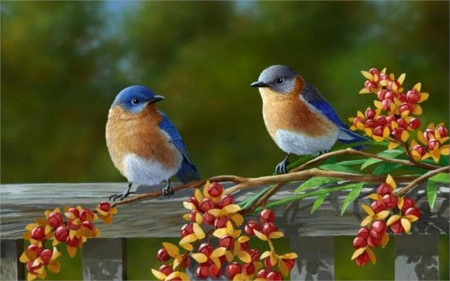
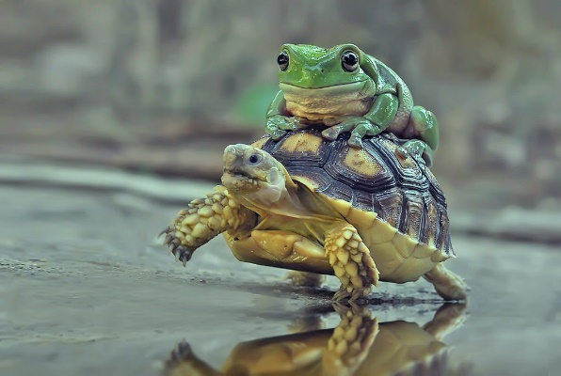
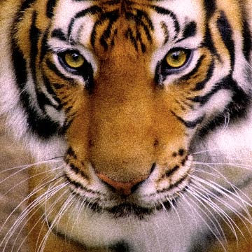
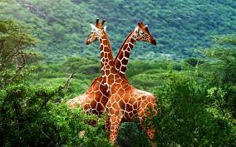
Laudato Si’, mi Signore
The Encyclical takes its name from St. Francis’ prayer: ‘Canticle of the Creatures’
‘Laudato si’, mi Signore
cum tucte le Tue creature’
“Praise be to you, my Lord
through all your creatures”
Laudato Si’ is subtitled: “On Care for Our Common Home”

Slide 4
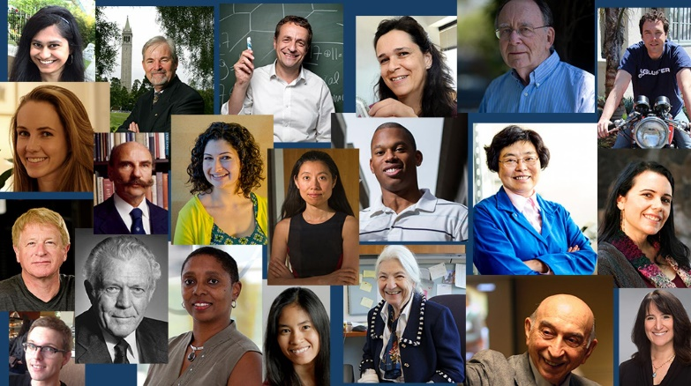
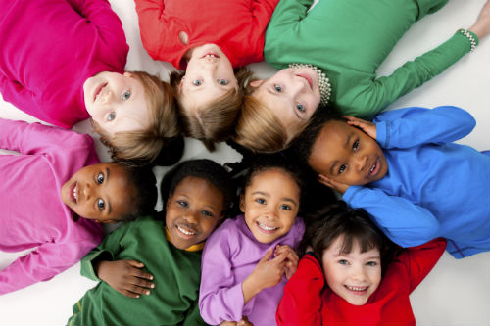
Laudato Si’ - to Everybody
Pope Francis’ encyclical letter, Laudato Si’ –
is addressed to “every person on this planet” (LS 3)
reminds us that all people on earth make up a single human family

Slide 5
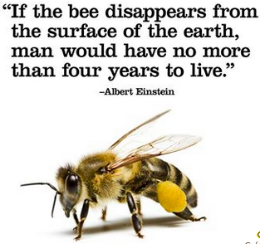
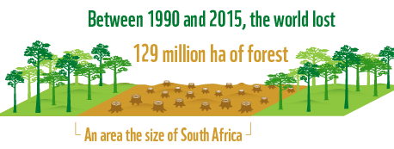
Laudato Si’ - Ecology
Laudato Si’ is concerned with the ongoing ecological catastrophic exploitation of nature and the world around us – our common home.
Pope Francis, ‘drawing on the results of the best scientific research available today’, discusses:
the exploitation and fragility of the planet
the conviction that everything in the world is connected
the effects of environmental degradation on the lives of the world’s poorest
the destruction of biodiversity
the throwaway culture
the proposal of a new lifestyle

Slide 6
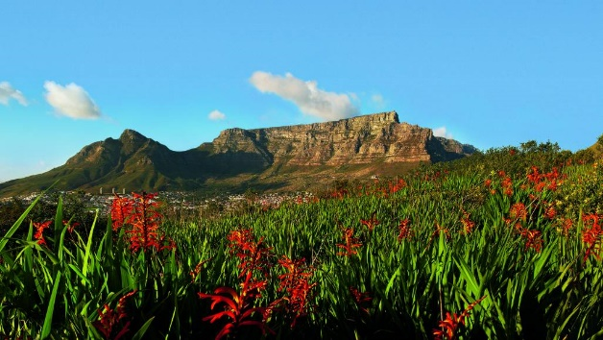
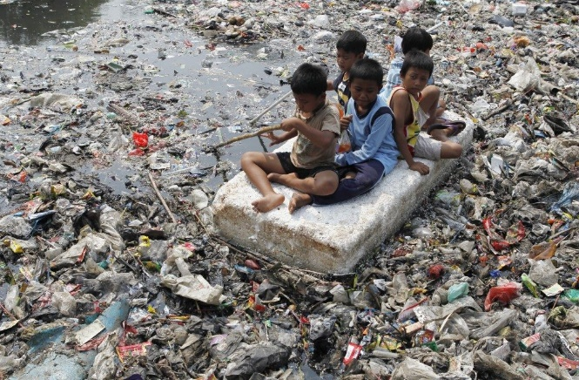
The Gospel of Creation
The Lord God took the man and put him in the Garden of Eden to work it and take care of it. Gen 2:15
The Stewardship model
The earth is not for our domination, but for us to take care of.
We too are creatures from the Creator.
We must ensure its fruitfulness for coming generations. (LS 67)

Slide 7
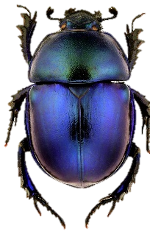
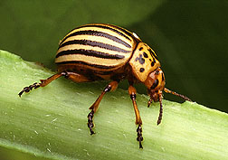
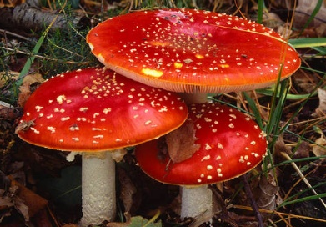
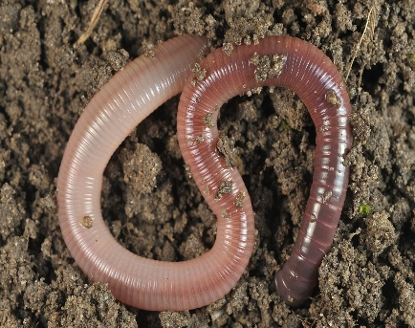
The Stewardship Model
A relationship of mutual responsibility between human beings and nature (LS 67)
We have a responsibility to care for the environment and everything in it (LS 67)
Earth belongs to God and is on loan to us (LS 67)
We must respect the laws of nature (LS 68)
Other living beings have a value in their own and God’s eyes…and glorify God by their mere existence (LS 69)

Slide 8
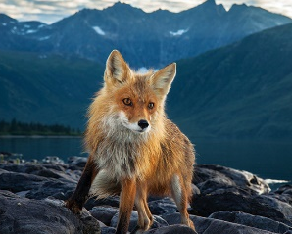
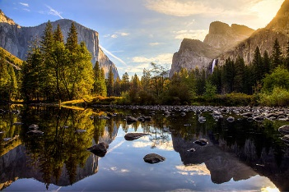
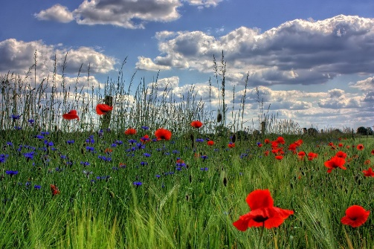
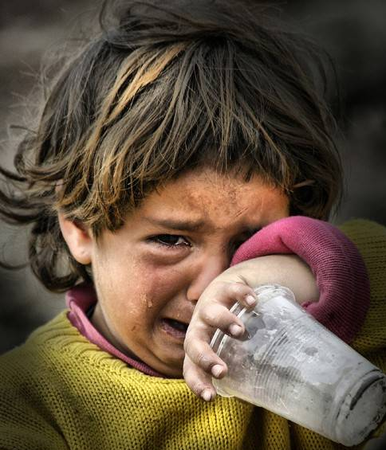
The Earth belongs to God and is on loan to us
St Francis of Assisi with ‘Brother Sun, Sister Moon...’ had a deep understanding of our interconnection as family members to all other created beings and inanimate elements
The challenge: to bring the whole human family together to seek a sustainable and integral development to resolve the effects of environmental degradation on peoples’ lives – especially the poor (LS 13)

Slide 9
World’s Worst Killer?
What do you think is the world’s worst killer today? Do you think -
war
hunger
violence
natural disasters
cancer
disease – Aids, malaria, tuberculosis? Discuss
This question will be considered again in a later slide.

Slide 10
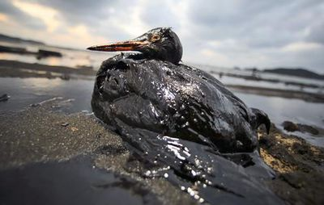
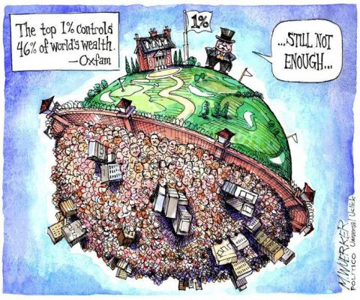
What is Happening to our Common Home?
Chapter 1 deals with global problems:
pollution and climate change
the issue of water
the loss of biodiversity
the decline in the quality of human life and the breakdown of society
Global inequality

Slide 11
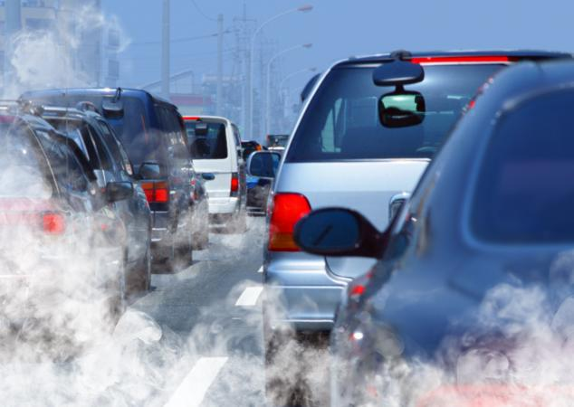
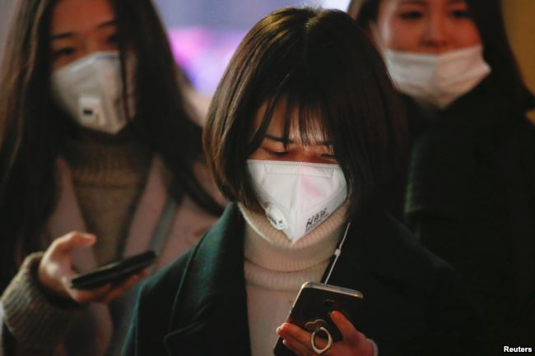
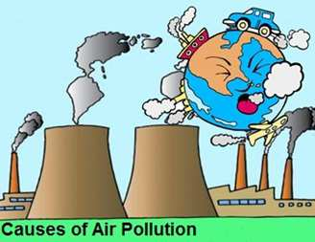
Pollution - Noxious Gases
Pollution by noxious gases:
fossil fuels, transport, insecticides, fertilisers, industrial fumes

Slide 12
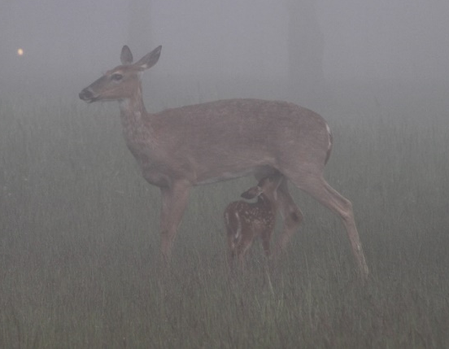
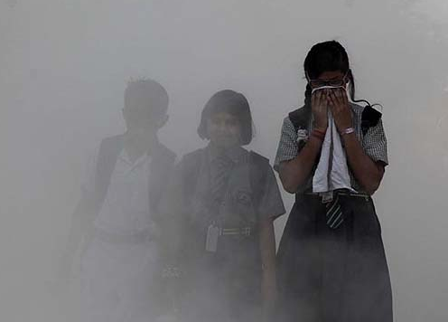
Pollution – ‘The Planet’s Dirty Killer’ Headline from article in NZ Herald 21/10/17
Environmental pollution (NZ Herald 21/10/17)
filthy air and contaminated water is killing more people on earth than all war and violence in the world
One in every six premature deaths in the world in 2015 – upwards of 9 million – was attributed to disease from toxic exposure (The Lancet, 2017)
Asian/Indian regions have most people at risk - one in every four premature deaths (NZ Herald 21/10/17)

Slide 13
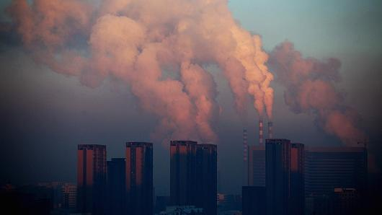
‘The Planet’s Dirty Killer’ (NZ Herald, cont.)
Poor countries:
have yet to set up air pollution monitoring systems
policies developing the economy takes priority over health
control regulations are weaker
technology is outdated
dirty fossil fuel is used
Financial cost from pollution-related death, sickness and welfare is US$4.6 trillion (NZ$6.58t) in annual global losses which is 6.2 per cent of the global economy.

Slide 14
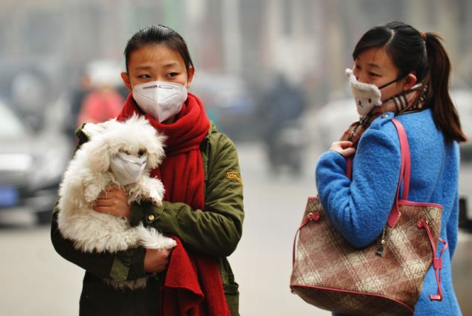
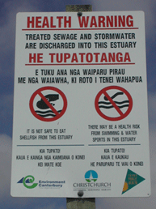
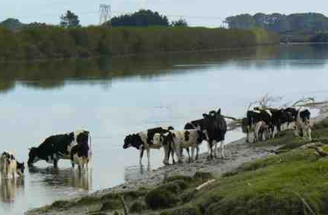
World’s Worst Killer?
What do you think is the world’s worst killer today?
war X
hunger X
violence X
natural disasters X
cancer X
disease – Aids, malaria, tuberculosis X
Pollution

Slide 15
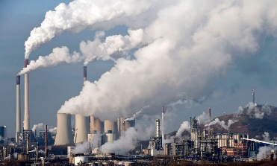
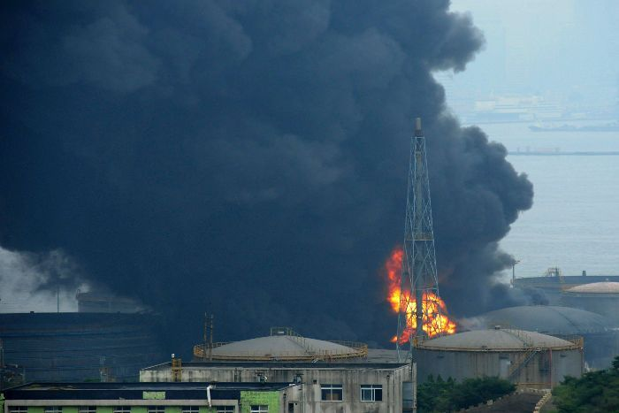
Fossil Fuels
coal, oil and natural gas are called ‘fossil fuels’ because they are found in the earth and were formed over millions of years from the remains of dead organisms
coal was formed from dead plant material such as trees
oil and gas were formed by marine organisms
when burned, the emissions from them harm the environment, producing greenhouse gases
these cause harm to the ozone layer

Slide 16
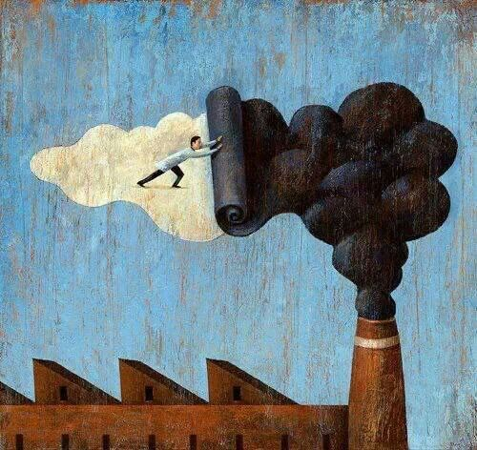
Pollution - climate
The climate is a common good belonging to all and meant for all (LS 23)
Greenhouse gases, mainly as a result of fossil fuel burning, don’t allow the warmth from the sun’s rays to be dispersed in space (LS 23)

Slide 17
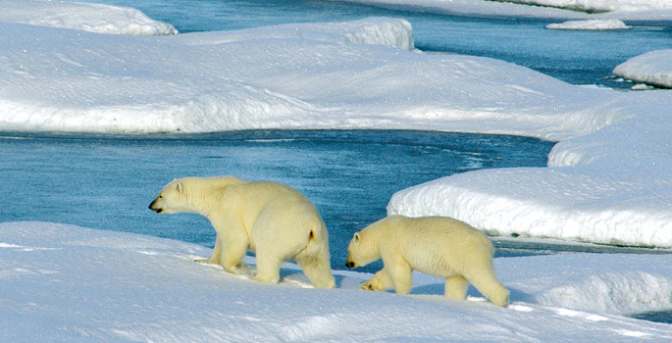
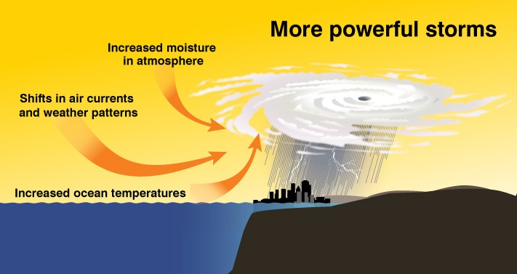
Effects of Pollution
Greenhouse gases cause:
melting polar caps
rise in sea levels
shrinking water supplies
droughts
frequency and strength of fires and storms
flooding and destruction (LS 23, 24)

Slide 18
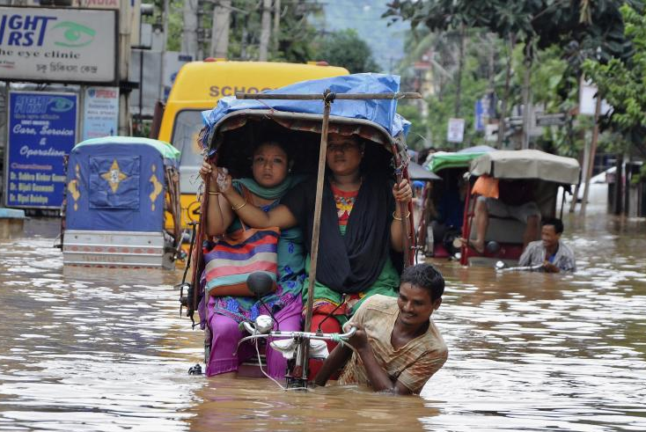
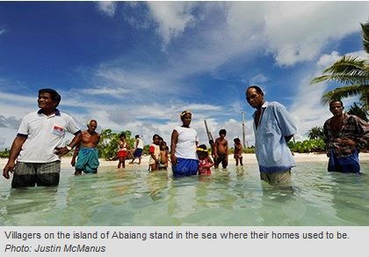
Greenhouse Gases
The worst impact is felt by developing countries, small islands and coastal areas.
Abaiang, an island in Kiribati in the Pacific Ocean. The sea is now where these people’s homes used to be.

Slide 19
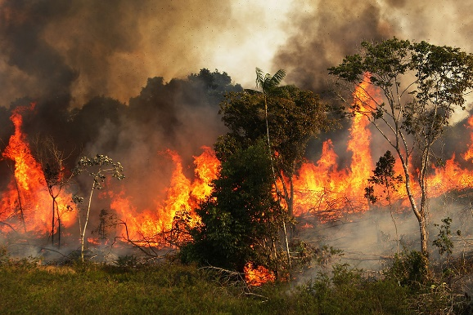
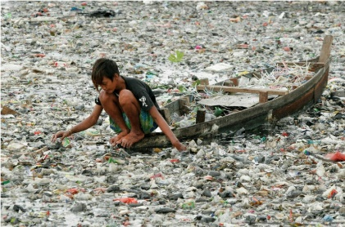
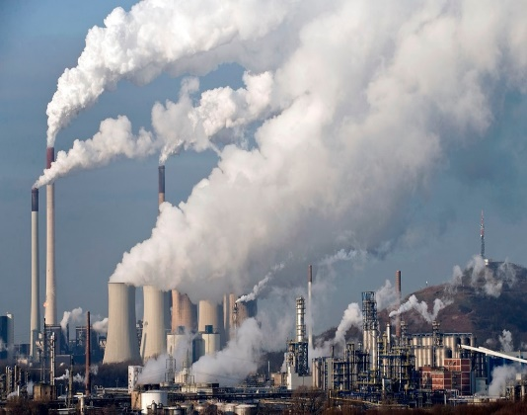
Pollution - Poverty
The poorest communities are the most often exposed to pollution.
Sick people can’t contribute to the economy but need to be looked after, costing the country more.
‘The relationship between pollution and poverty is very clear.’ Ernesto Sanchez Triana, environmental specialist, World Bank.
‘Reducing pollution in all forms would now be a global priority’. World Bank (NZ Herald 21/10/17)
The United Nations hosted its first ever conference on pollution in December, 2017

Slide 20
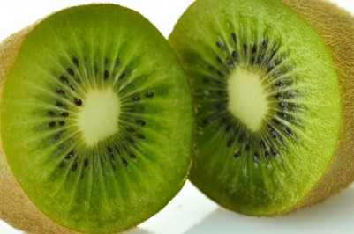
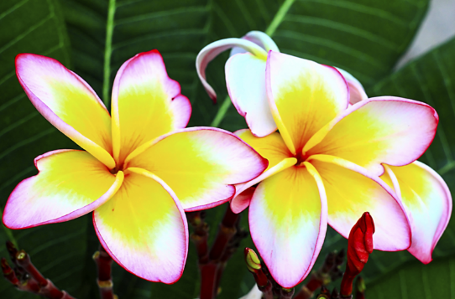
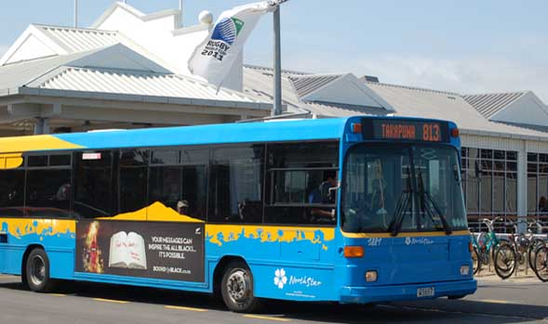
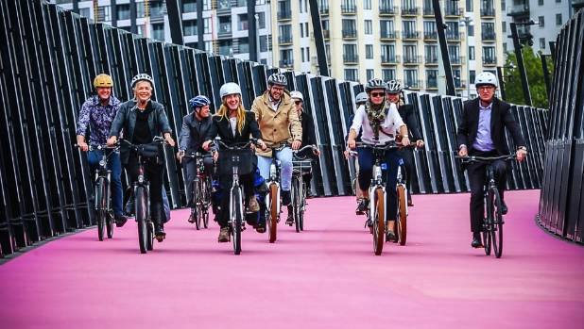
What can we do?
be energy efficient – switch off lights and electronics when not in use
walk or ride a bike instead of taking a car
OR - car pool or use public transport
buy locally grown food
compost food waste (landfills produce methane gas)
plant vegetation and trees - these help to remove greenhouse gases

Slide 22
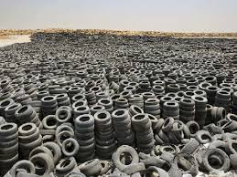
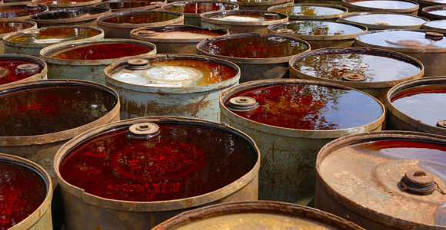
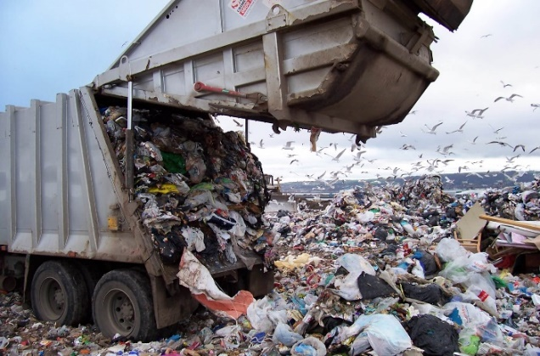
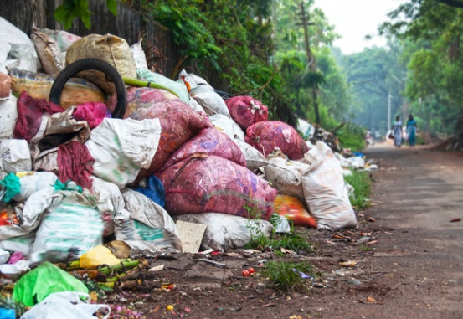
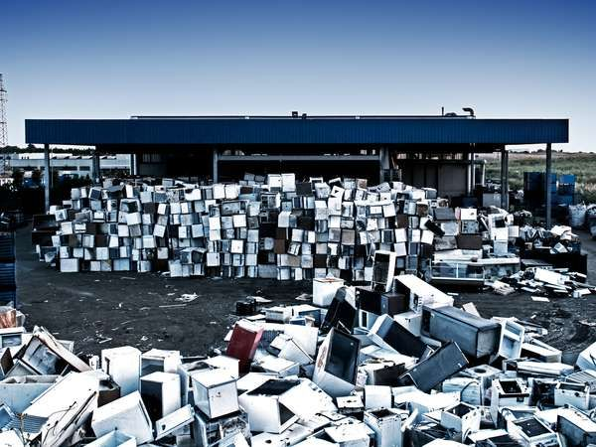
Pollution - Rubbish
Rubbish – millions of tons of waste, highly toxic and non-biodegradable wastes, plastics, industrial waste

Slide 23
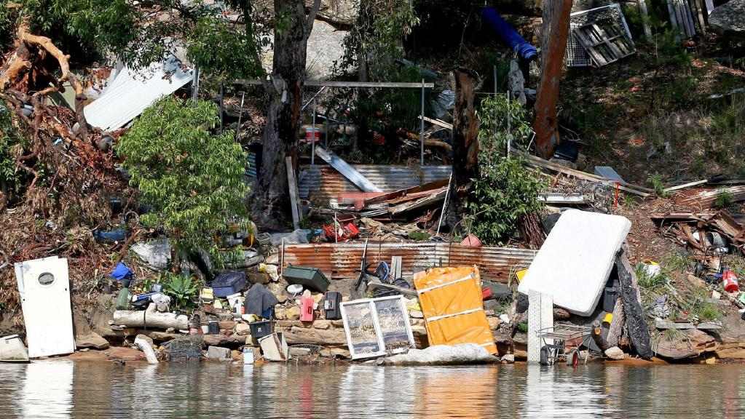
Our Common Home
‘The earth, our home, is beginning to look more and more like a pile of filth’ (LS 21)
‘These problems are linked to a throwaway culture’ (LS 22)
Discuss: re-use, recycle, restore, replace, reduce, refuse
What do I do, what do I need to do?
23

Slide 24
Reduce Pollution
Re-use – can I make use of this product again?
Recycle – can it be converted into another product or can someone else make use of this?
Restore – can I update this product instead of buying a newer one?
Reduce – do I need to buy more ‘stuff’?
Refuse – how many plastic bags, cups, lids, drink bottles, straws, toys, cartons etc. am I using??? Say ‘NO’ to Plastic!

Slide 25
The Issue of Water
Fresh drinking water – in many places demand exceeds the sustainable supply (LS 28- 29)
In Africa large sectors of the population have no access to safe drinking water
The unsafe quality of water available to the poor results in many deaths
Inadequate hygiene causes cholera and dysentery
Mining, farming, industrial/domestic chemical products pollute rivers, lakes and seas
Safe, drinkable water - a basic human right

Slide 26
Water – a basic human right
In many poor countries the task of collecting water falls mainly to women and girls.
Many girls cannot attend school because the walk to the source of their water is a long distance away and takes hours each day.

Slide 27
NZ Water Pollution
Many NZ rivers, lakes and beaches are polluted and unsuitable for swimming:
run-offs from fields, roads
discharges from industries
burst/flooded domestic sewerage ……………..ETC….
everything that goes down the drain ……………..
all end up in the river/sea

Slide 28
Sea Pollution
How bad is it?

Slide 30
Ocean Life
Oceans contain: (LS 40)
most of our planet’s water supply
an immense variety of living creatures
most of them are still unknown to us
Marine life, which feeds a great part of the world population, is affected by pollution and uncontrolled fishing, endangering sea life.
Dead orca with stomach full of trash

Slide 31
Pollution of the Oceans
There are many kinds of pollution in the oceans and seas:
rubbish, chemicals, oil, sewage from toilets and….
PLASTIC – birds, marine mammals, and fish are most affected by plastic in their diets
this in turn affects all the other creatures that eat the birds and sea creatures – including US

Slide 32
Sea Pollution - how bad is it?
60-90 percent of marine litter is plastic-based
At least 8 million tons of plastic enter the oceans each year
80% of ocean pollution is from land based sources
There is more microplastic in the ocean than there are stars in the Milky Way
Over 100,000 marine animals die every year from plastic entanglement and ingestion
Ocean pollution kills more than one million sea birds each year
Dumping trash into the Amazon
Trash Island in the Caribbean

Slide 33
Pollution of Water - what can we do?
Don’t leave rubbish lying around on beaches or beside rivers and lakes
Don’t throw rubbish into the sea or into rivers or lakes
Organise or help in a beach clean up
Help to take care of a local stream
Make sure only rain water goes down the drain/toilet - most drains flow straight to the sea
Conserve water – turn off taps

Slide 34
The Loss of Biodiversity
Each year thousands of plant and animal species disappear, becoming extinct due to human activity
The plight of endangered birds, animals and sea creatures may disturb us, but fungi, algae, worms, insects, reptiles and micro-organisms are all necessary for our ecosystem to function well
The cause is often due to economic interests and consumerism (LS 32)
Consider - the Amazon and Congo basins, deforestation, trading in animal parts, loss of species’ habitats
A bewildered koala after deforestation

Slide 35
The Throwaway Culture
We are a disposable contemporary society updating:
cars, phones, digital/electronic devices….every ‘latest and greatest’
‘me in the moment’ for maximum pleasure with no thought to future generations
global inequality – the minority live extravagantly, the majority in great poverty
the decision-makers are most often far removed from the poor, who are at the bottom of the pile (LS 49)
the cry of the earth echoes the cry of the poor

Slide 36
The ‘Me’ Culture
Practical Relativism – sees all as irrelevant unless it serves one’s own immediate interests, leading to one person taking advantage of another (LS 123)
On the grand scale this becomes:
human trafficking, drug trafficking, blood diamonds, child soldiers, ivory/tiger skin trading, forced labour, exploitation of the elderly and children, organised crime, greedy economies

Slide 37
Decline in the Quality of Human Life
When a culture is corrupt, and objective truth and universally valid principles are no longer held, laws are seen to be impositions or obstacles to be avoided. (LS 123)
We know that countries which have clear legislation about the protection of forests and animals continue to keep silent as they watch laws repeatedly being broken (LS 142)

Slide 38
Principle of the Common Good (LS 156)
Underlining the principle of the common good is:
respect for each human person, who is endowed with basic inalienable rights (LS 153)
an appreciation of the immense dignity of the poorest of our brothers and sisters (LS 158)
ensuring attainable housing for all, giving people a sense of personal dignity and family wellbeing (LS 152)
giving priority to public transport (LS 153)
an awareness of what we are leaving for future generations

Slide 39
Things must change (LS 202-227)
Consumerism – Christian tradition calls to
ecological conversion
simplify our lifestyles, move away from ‘buy more’
be mindful on all purchasing – consider how our buying impacts on other people and things
be content with the necessities of life
be present to the moment – music, art, beauty, in tune with God
be aware that ‘the cry of the poor’ is not just from the human family

Slide 40
A New Solidarity
Time to act as individuals and communities
Political action - Catholic Christians of good will are called to do something
Need to prioritise on a local level
There needs to be dialogue and transparency in decision making
Political and economic transparency to eradicate corruption

Slide 41
All it takes…..
All it takes is for one good person to restore hope (LS 71)
Whenever food is thrown out it is as if it were stolen from the table of the poor (LS 50)
Every act of cruelty towards any creature is ‘contrary to human dignity’ (LS 92)
It is essential to show special care for indigenous communities and their cultural traditions (LS 146)
Practise St. Thérèse’s little way of love – a kind word, smile or small gesture which sows peace and friendship (LS 230)

Slide 42
All it takes…..
The environment is on loan to each generation which must then hand it on to the next (LS 159)
Interdependence obliges us to think of one world with a common plan (LS 164)
A global consensus is essential for confronting the deeper problems which cannot be resolved by actions of individual countries (LS 164)
Notes:
“

Slide 43
All it takes…..
….is for one good person to restore hope………
What can I do to restore hope?

