Slide 1


Breaking Open the SREBD
Why have we got it? What’s in it?
Session - 1
Notes:
Quick note – The SREBD has been written with input from NCRS, Bishops, REAs, Teachers, and lots of anecdotal evidence from families and whānau. It has been written to help secondary teachers teach RE – not just to create more work.

Slide 2

Blessing - Karakia
E te Atua, God our loving Father,
You gift us with this world and invite us to respond with love and wisdom
Hehu Karaiti, Jesus Christ, beloved Son,
You show us how to live and call us to participate in your mission of life
Wairua Tapu, Holy Spirit,
You empower us with your will and guide us on our shared journey.

Slide 3
Blessing - Karakia
Bless the children, young people and whānau in our parishes and their Catholic school communities
Bless all who work in Religious Education in Aotearoa New Zealand,
Remind us that you are always with us,
Fill us with enthusiasm, knowledge and joy
To teach and learn that which is at the heart of our schools,
You, who live and reign for ever and ever.
Amene
Notes:
Begin with the Blessing – Karakia at the start of the REBD p4. After praying it draw out some of the aspects that are at the heart of this document.
We acknowledge that God is the foundation and inspiration for our work.
God is with us and gifting us in our work as we respond to Jesus’ Call to participate in his mission.
We ask, first, that the children and families be blessed
We ask that we be blessed in our work.
We acknowledge that for ourselves and our kids, we need to be enthusiastic, knowledgeable and joyful
It is Jesus who is at the heart of our schools and all of us are teaching and learning in our Catholic school community.

Slide 4
First of all…
The SREBD was written in response to requests by many DRSs, principals, teachers & whānau.
It is the product of lots of formal and anecdotal consultation & feedback, though not with everyone.
It’s designed to be used in all Secondary Catholic Schools in Aotearoa NZ.
It is a step towards a new curriculum over the next five years.
In response to Laudato Si’ & modern teaching it has not been ‘printed’ but is published only in pdf format.
Notes:
It seems a good idea to address some key, basic questions at the outset. This isn’t really designed for Q & A just a quick ‘flick through’ and then into the meat of the meeting.
It hasn’t come ‘out of the ether’. In fact, work has been happening over the past 5 years around reviewing the secondary RE curriculum, but due to a range of factors nothing has eventuated. It was decided to ‘start from scratch’ and write a useful bridging document that could be completed within 12 months.
Not everyone has had input into this document but through minutes of past meetings, REAs and several schools from each diocese there is huge input from NZ Catholic classrooms. It’s not just a few people deciding to write from a desk behind closed doors.
It should be useful and can be used immediately.
It provides time and focus for collectively investigating a NEW RE curriculum. NCRS will be researching and driving this over the next 5 years. Schools will be involved in this process.
We’re not going to print it, but it’s designed so that schools can print part or all of it themselves if they wish.

Slide 5


Session 1 - Overview
At the end of this session, teachers will have a reasonable idea of why we have the “Religious Education Bridging Document” and be able to position it in relation to the “Understanding Faith – Religious Education Curriculum Statement for Catholic Secondary Schools – Years 9-13”
Notes:
Draw attendees attention to the Understanding Faith – RECS (revised in 2010). Available on FaithCentral under Admin in the staffroom. N.B. All Catholic Secondary Schools were sent a spiral bound copy with the blue cover in 2011, but the FC pdf version doesn’t have a cover. Call for a quick ‘show of hands’ as to who is aware of this document and then who regularly uses it. Comment that anecdotal evidence is that many DRSs and teachers don’t really know it exists.
Let’s explore the a-z of the Secondary Religious Education Bridging Document, starting with 3 sessions to overview exactly what it means for us in the secondary school context. So, this first session, is really just ‘introducing’ the SREBD itself.
First things first: What is the SREBD?

Slide 6
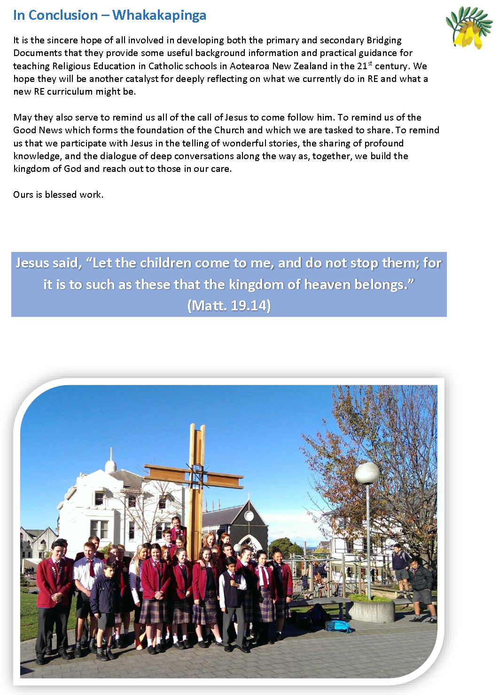
Let’s have a look…
Compare the ‘Forewords’ of each document
What’s different or the same?
Then, read the Introduction of the REBD.
How does that resonate with Vision Statement on p7 of the UF-RECS?
Now, consider the Conclusion p21
Notes:
Ask teachers to work in small groups to complete a simple Venn diagram to compare and contrast the forewords from the 2 documents (i.e. p1 of the SREBD and p6 of the UF-RECS)
When completed and shared, click to the next point and consider the Introduction.
Finally, invite staff to independently read the Conclusion from page 20, then to identify a word or phrase that is particularly striking for them and to share that with others.
Finish this discussion by highlighting the Scripture quote from Matthew: “Let the children come to me…”

Slide 7

So…
+
Does the REBD replace the RE Curriculum Statement?
We still have one Curriculum, we still teach the same body of knowledge.
And, the SREBD simply revisits CONTEXT and gives some GUIDANCE for teaching RE TODAY.
Notes:
Please, share with those present that NCRS is beginning the process of writing a completely new level 1 – 8 curriculum over the next 5 years or so. Teachers will certainly be very involved in that journey but… it’s going to take a while to do that well. In the meantime, this SREBD gives some clear direction NOW! (Written in response to many requests over the past few years by principals, DRSs and other teachers.)

Slide 8
It’s designed to be used for…
Reminding and/or informing BOTs, whānau, teachers etc. what Religious Education is all about.
It supports the significance and importance of RE in Catholic schools.
Encouraging a new look at RE at your place.
Generating reflection and discussion around how the Understanding Faith curriculum is being implemented.
Developing a shared understanding of RE from which we can move to a new RE curriculum.
Notes:
In some schools the place of RE is challenged and sometimes eroded. The SREBD gives principals and DRSs another clear tool for asserting the significance and importance of RE.
The many areas within the SREBD draw specific attention towards different aspects.
Particular sections are designed to be used in whole staff or department/faculty meetings, or even with BOT and whānau.
We need to really focus on the strength of what we have before moving to a new curriculum.

Slide 9
The SREBD at a Glance…
The main headings of the REBD are intended to convey the key ideas of the contents:
Being Spiritual - Te Taha Wairua Being Catholic Today. Young People’s spirituality is diverse, modelled by teachers [and] oriented towards Jesus.
Considering our Learners - Ngā Ākonga Widely varied, seeking to belong, come as you are.
Being Bi-Cultural - Te Tikanga-rua Taonga, Ako [and] Whānau
Understanding Religious Education - Te Mātauranga Whakapono Growing together in a climate of faith.
Notes:
This gives a real insight into the intention and direction of the SREBD.
Say the heading and then get someone to read out the sub-heading below it.
Take a few seconds before doing the same with the next heading. Let the phrase sink it.
Acknowledge that it doesn’t work ‘perfectly’ in terms of sentence structure. But, it’s the content of the document, and the sequence of the text, that is leading this mechanism, not the headings themselves.

Slide 10
The SREBD at a Glance…
Becoming Religiously Literate - Te Reo Whakapono A language of faith supporting the practice of faith.
Assessing and Evaluating - Te Aromatawai me te Arotake Assess Religious Education, seeing the bigger picture, evaluating beyond the cognitive [and] broadly applying strategies. (Including Reporting).
Applying Pedagogy… - Ngā Ariā o te Mātauranga Whakapono Engage deeply, with particular knowledge, encouraging a relationship with Jesus – creatively and enthusiastically.
Notes:
Continue as with the previous slide.

Slide 11

The SREBD at a Glance…
Using the SREBD – Te Whakamahinga o te Puka Whakawhiti Rejuvenate Religious Education with creativity, faith, knowledge and skill.
Looking at the Contents pages of the SREBD…
What words particularly leap out for you?
Notes:
In response to the question - share with the person next you to. Perhaps, some general sharing if that seems right with the group.

Slide 12

What does all that mean for me?
NCRS is aware that many have been seeking a revitalised programme with re-arranged, or new, topics and themes which speak more clearly to, and better engage, the young people in Catholic secondary schools today. There is a growing desire and enthusiasm to do things better and to do more than just ‘rearrange topics’ for this important mahi. (p5)
Therefore, in response to the needs of teachers, young people and parents in today’s context this document serves to provide a bridge, for developing teaching of Religious Education, between past and contemporary learning environments.
We’re still teaching the same curriculum
And we are expected, and allowed, to teach RE in a way which is engaging and inspiring for the children and ourselves.
As page 5 of the SREBD states…
Which is NOT to say we weren’t already doing that!!
Notes:
This is just to be REALLY clear. Some teachers have felt that they are completely bound by the books. While they are expected to teach the mandated programme they are also allowed and strongly encouraged to be really creative in what they do.
The SREBD re-grounds us in what we’re supposed to be doing in RE – it opens the door a crack to start getting really creative while not throwing the baby out with the bath-water. (Or, it gives permission to stay creative, engaging, fun-filled and dynamic in your teaching of this wonderful subject while ensuring we teach what the NZ Bishops ask of us.)

Slide 13

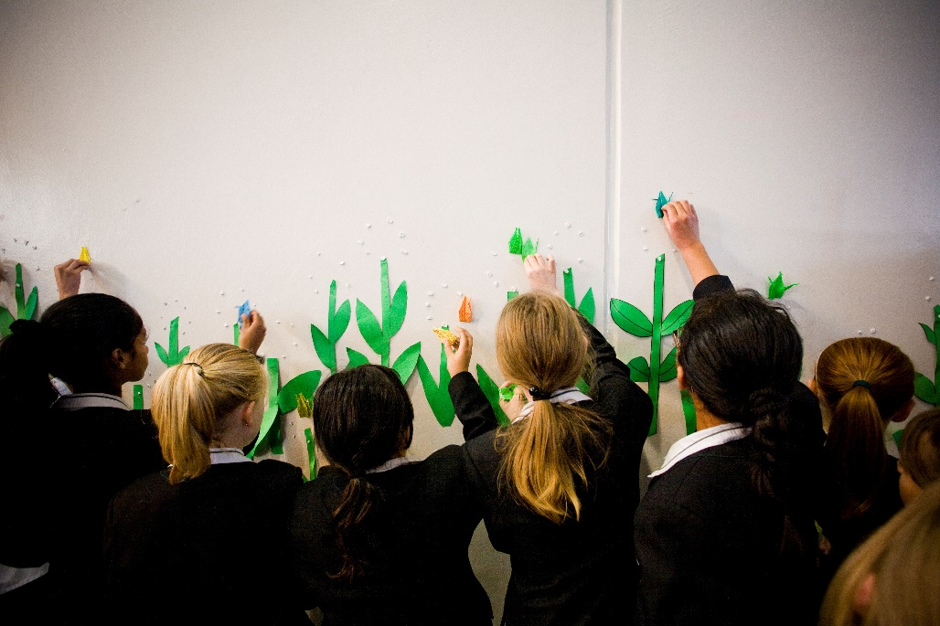
Think and Share
Why did it work so well?
What Achievement Aims and Objectives were you meeting?
Think of an example of an RE lesson or experience
which was brilliant!!
Notes:
This is a chance to think about and share some really positive experiences.
Wait a bit before showing the first bullet point after the “task card”.
WAIT again before bringing up the second point. Be conscious that there’s often a sense that, “To do RE creatively you have to forget the curriculum.” – The REBD is trying to help bring more cohesion in response to this sentiment. To do RE well we need to use the curriculum well and keep focussed on what we are doing. – Otherwise… it might not be RE.

Slide 14
So… to support more wonderful RE…
This new document has been written to help us Look Anew at RE.
Notes:
Remember, this is an introductory session to the SREBD so we’re not heading immediately to the Achievement Aims and Objectives. BUT – that will be covered in more detail in another session.

Slide 15
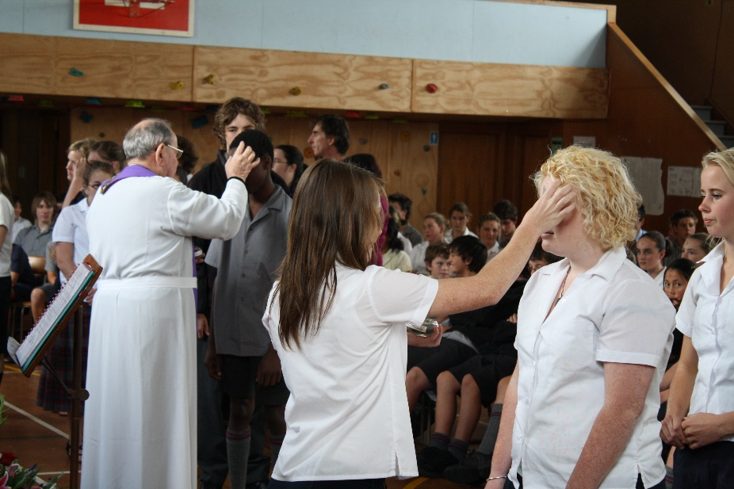
Where else does the ‘bridge’ take us?
In particular the SREBD supports renewed consideration of:
Opportunities for encounter with the person of Jesus
The relationship between school and parish
The spirituality of young people and the context of those in our schools
The significance of cultural responsibility and identity
Notes:
These are the challenges highlighted within the document. Not just for schools – but challenge for the wider parish too.

Slide 16
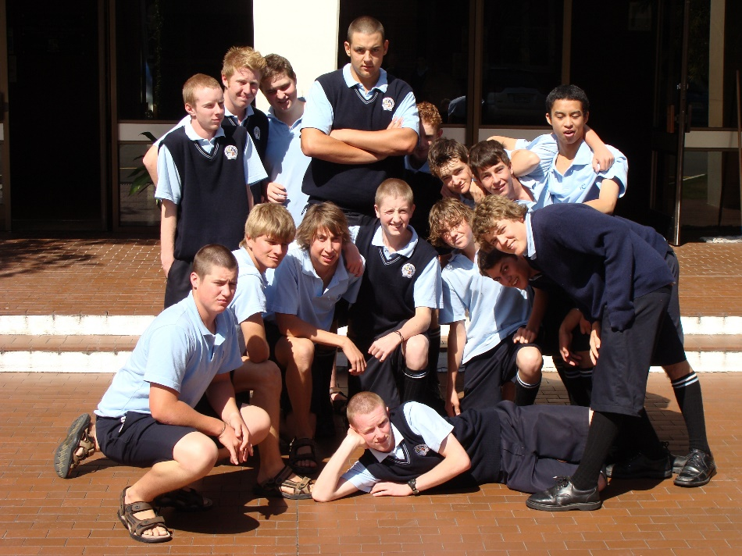
Where else does the ‘bridge’ take us?
In particular the SREBD supports renewed consideration of:
What we understand Religious Education to be (structure, purpose & religious Literacy)
Effective assessment and evaluation
Varying pedagogies
The actual breadth of the current, mandated curriculum

Slide 17
Session 1 - Overview
At the end of this session, teachers will have a reasonable idea of why we have the “Religious Education Bridging Document” and be able to position it in relation to the “Understanding Faith – Religious Education Curriculum Statement for Catholic Secondary Schools – Years 9-13”
YES?
(Questions?)
NO?
Notes:
Have we done what we said we would in this session?

Slide 18
Scripture to finish with…
Something which has existed since the beginning,
that we have heard, and we have seen with our own eyes;
that we have touched with our hands:
the Word who is life - this is our subject.
What we have seen and heard we are telling you
so that you too may be in union with us, as we are in union
with the Father and with his Son Jesus Christ.
1 John 1:1,3
Notes:
This concluding scripture is from page 8 of the Understanding Faith - Religious Education Curriculum Statement.

Slide 19

Go Well, God Bless
We’d love to get some feedback:
www.tinyurl.com/rebdnz
Notes:
Just an opportunity to give some feedback – this is a link to a short Google Form. Not, compulsory. ☺

