Slide 1


Breaking Open the SREBD
Delving Deeper.
Our Schools, RE & Spirituality?
Session - 2
Notes:
Quick note – The SREBD has been written with input from NCRS, Bishops, REAs, Teachers, and lots of anecdotal evidence from families and whānau. It has been written to help secondary teachers teach RE – not just to create more work.

Slide 2

Blessing - Karakia
E te Atua, God our loving Father,
You gift us with this world and invite us to respond
with love and wisdom
Hehu Karaiti, Jesus Christ, beloved Son,
You show us how to live and call us to participate in your mission of life
Wairua Tapu, Holy Spirit,
You empower us with your will and guide us on our shared journey.

Slide 3
Blessing - Karakia
Bless the children, young people and whānau in our
parishes and their Catholic school communities
Bless all who work in Religious Education in
Aotearoa New Zealand,
Remind us that you are always with us,
Fill us with enthusiasm, knowledge and joy
To teach and learn that which is at the heart of our schools,
You, who live and reign for ever and ever.
Amene
Notes:
Begin with the Blessing – Karakia at the start of the REBD p4. After praying it draw out some of the aspects that are at the heart of this document.
We acknowledge that God is the foundation and inspiration for our work.
God is with us and gifting us in our work as we respond to Jesus’ Call to participate in his mission.
We ask, first, that the children and families be blessed
We ask that we be blessed in our work.
We acknowledge that for ourselves and our kids, we need to be enthusiastic, knowledgeable and joyful
It is Jesus who is at the heart of our schools and all of us are teaching and learning in our Catholic school community.

Slide 4
Session 2 - Overview
At the end of this session, teachers will have
re-visited some understandings of
Catholic Schools,
Religious Education &
Spirituality
as woven throughout the Secondary Religious Education Bridging Document.
Notes:
These are themes that flow throughout the document and which also have quite specific new direction from the previous, 20 year old, curriculum.

Slide 5
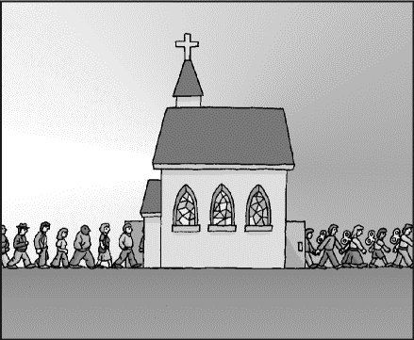
Naming a few misconceptions
“Out There”…
Being in a Catholic School is not about…
Focus only on Children
Some Catholic ‘bolt-ons’
Memorising the Catechism
Brain Washing
Being disconnected from the real world
A random set of values
Being elitist
Being excluded
Stronger discipline
Notes:
These are all things that have been heard from parents considering sending their child to a Catholic School.
Secular society enjoys thinking that we ‘churn out’ non-thinking, religious robots. (or that sensible thinkers never enter a church in the first place.)
Think about each of these points. – Would you add any others?

Slide 6
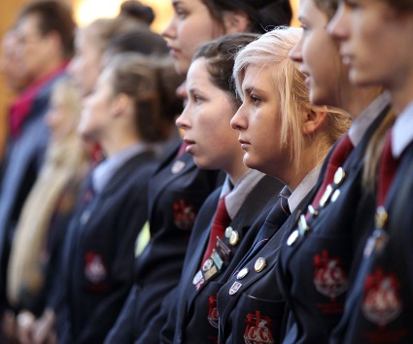
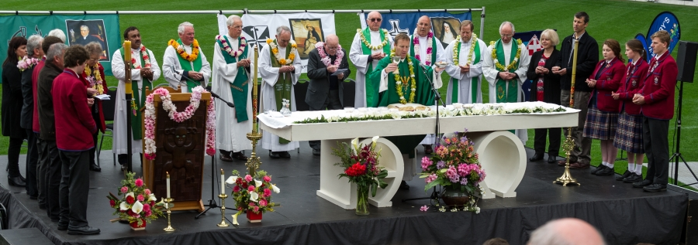
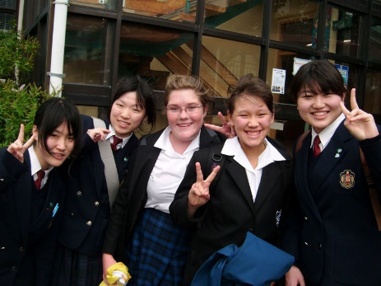
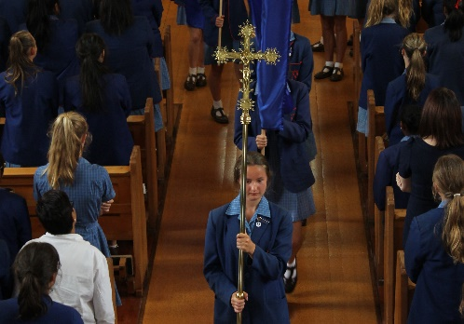
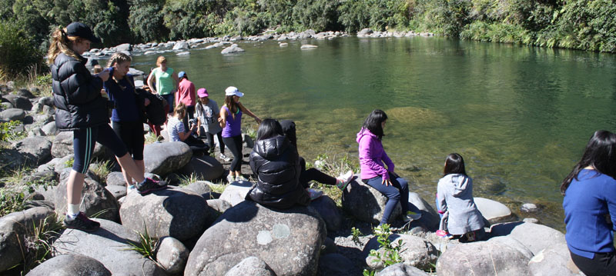
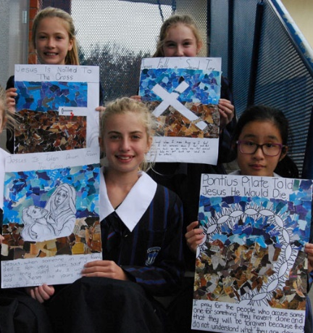
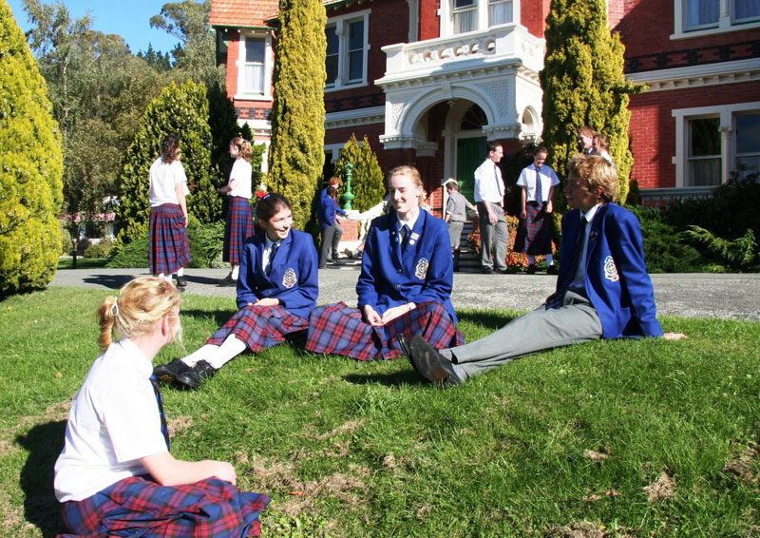
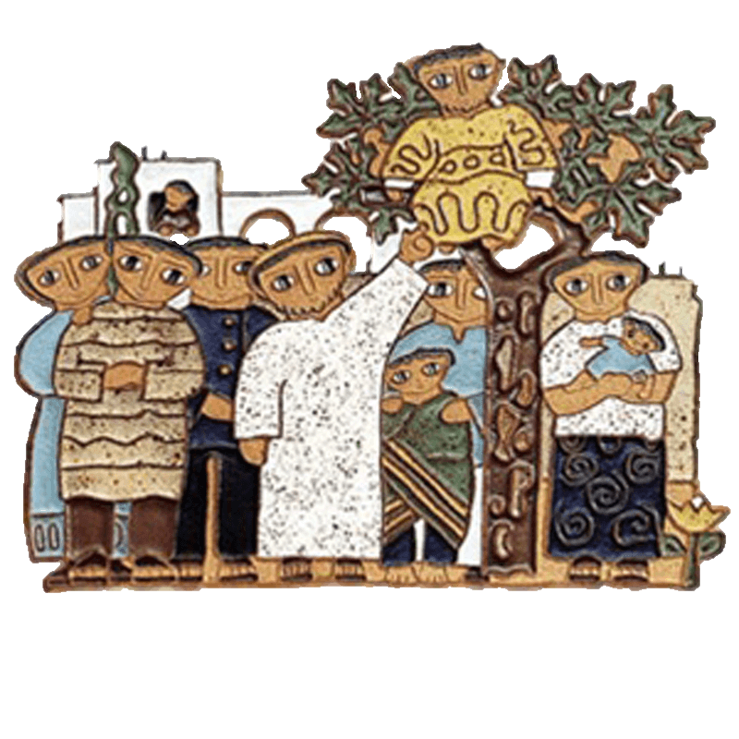
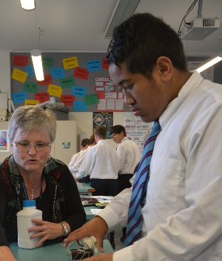
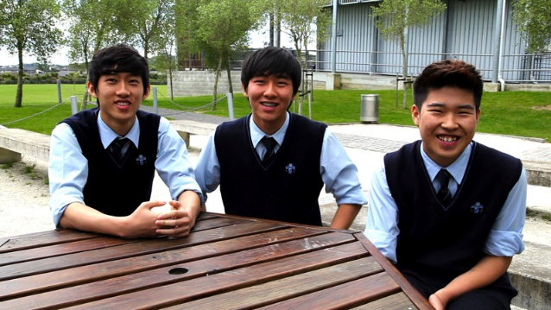
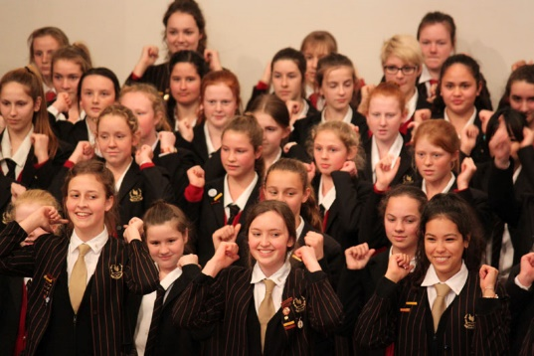
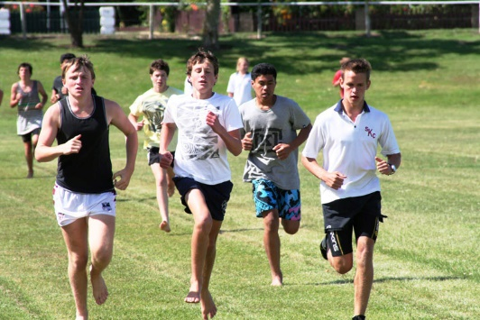
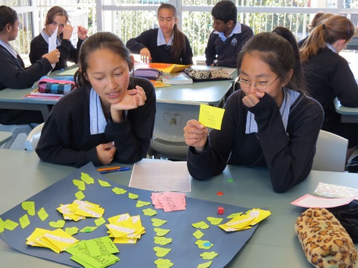
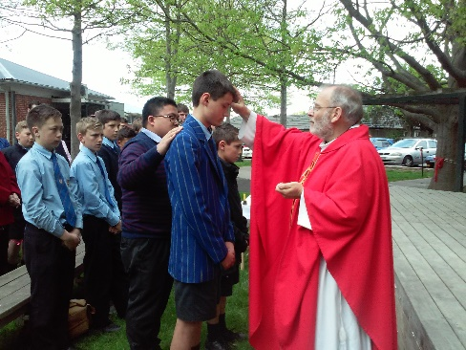
Our Catholic Schools are about…
Encountering Jesus
Focus on Community
Being Fully Catholic
Learning and Thinking in RE
Challenging and Engaging
Being deeply connected to the real world
A grounded set of virtues & values
Being people of justice
Being included
Pastoral Care
Notes:
Each of these points is a ‘translation’ of the former into what actually happens in Catholic Schools. All of this happens within the Catholic Character of a school and RE informs each part as well as being an key aspect in its own right.
Next click – shows ceramic of Jesus with Zacchaeus. (AND, in our schools Jesus is at the centre of all this.) Not a person distant and remote, but guiding, informing and sharing – in our midst and through the Gospels. Think of all the stories and occasions of Jesus doing and saying things like (mention the example on each click and appearance of an arrow) you may, of course, use other examples than these:
Community – All the meals, going to synagogue and crowds.
Pastoral– Touching the lepers and other sick
Virtues– The Golden rule & the Beatitudes
Challenging - “Give to Caesar what is Caesar's”
Catholic – Grounded and always reaching out – The Last Supper, Road to Emmaus
Learning – All those parables and challenges to think anew
Justice – The Good Samaritan
Included – The Woman at the well,
Connected – Weeping at the death of Lazarus, basing his teaching on farming, travelling, everyday relationships, etc.

Slide 7
So… Being ‘Real’
“In a Catholic school teaching is much more a vocation than a profession. It is an opportunity to participate in the mission of Jesus by sharing his Good News with the children and young people in our care and their families in our community.” (p. 4)
“Teaching Religious Education is hard work, especially
in the face of growing secularisation and increasing
demands on teachers’ time in terms of compliance
and professional expectations.” (p. 4)
Notes:
At the core of the REBD is a deep awareness of the reality of teaching RE in our schools today. We need to be ‘conscious’ – to bring to mind – that teaching in a Catholic schools is responding to a Calling. (It can’t be just a job – well… it can… but it’s so much better for everyone, especially the teacher, if it’s more.
The Bishops KNOW that it’s hard work. They know that there are so many other demands and pressures on teachers.

Slide 8
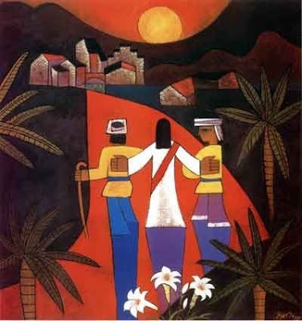
So… Being ‘Real’
“Yet this is what Jesus calls us to do, to recognise that in the face of a changing world, fluid values,
inconsistent justice, increased individualism and often a decreased awareness of God’s presence,
the teacher of RE chooses to be the
instrument of a different message…” (p. 4)
Notes:
But… as we know… we need to get on with it anyway.
Each click underlines the key phrases on this slide. At each one, ask people to volunteer examples (or share with the person next to them).
YET, amidst ALL of this… the teacher of RE chooses to be the instrument of a different message – good news.
The idea behind the final text in the box is… Yes, Teachers are required to teach RE in our schools BUT everything we do is always a choice. In applying for a position in a Catholic school, in taking on RE, we are responding not just to the boss, or the BOT, but to Jesus’ Call - to teach his message. (And it’s a wonderful message of hope, trust and love.)

Slide 9
So… Being ‘Real’
We are called to respond to the very call of Jesus.
“It’s Good News. The really tricky part for teachers is holding on to enthusiasm, creativity and
energy in the midst of so many other
demands on their time and work.”
(Aoraki – August ‘17)
Notes:
This might seem a bit heavy. It’s not intended to be. It’s not focussed on demanding that people need to be Catholic or even Christian, it’s more bringing to the fore that in a Catholic School the person of Jesus is at the centre of what we do. And, it’s ‘brilliant’!! (Not weighty, or energy-draining – but wonderful and life-giving.)
But… back to the hard work bit… we know there’s lot’s going on and it really can be tough holding on to the good stuff. But we just have to. No-one wins otherwise. At the core of RE teaching – is Good News.

Slide 10

Notes:
Just gotta love this! Sometimes, we’ve just have to strap on the helmet, goggles and wings and go for it.

Slide 11

Welcoming people to share fully in this community
Notes:
Now, having said all that – one elephant in the room (or mouse) is that RE is NOT directly about Evangelisation. We are NOT trying to convert anyone in RE, but… we ARE trying to provide knowledge of the Good News in a way which is engaging and dynamic. As Pope Francis is so often saying we need to be honest and joyful about sharing in Jesus’ work, and sharing our own faith – and when we do so it is wonderful to see what happens.
If it’s scary, or confrontational – we’re probably not doing it right. (We also don’t need to, and shouldn’t be, apologetic about our Catholic Character. Going back to the ‘misconceptions’ slide, our schools are great ‘because they believe in Jesus’ not despite this belief.) ☺

Slide 12

Understanding Religious Education
2 Minutes
RE is not Catechesis – but forms a foundation from which personal faith may grow. (p. 13)
There is a deep link to spirituality – the drawing together of knowledge and experience. (p. 7)
Learning “about” Jesus can grow to learning to “love Jesus” (p. 13)
This happens in a context of community – whānau, parish & school. (p. 13)
What is Religious Education?
Notes:
So… without consulting the SREBD just have teachers chat among themselves about “What is RE?” (Once clicked to bring up the question a two minute timer bar will begin at the top.) Give them 2 minutes and then feedback to the large group. Be positive – there’s a lot of wisdom and experience in this area.
Then, get everyone to read p13, Understanding RE – Te Mātauranga Whakapono, and then move through each point on the rest of this slide. Allow, time at the end of this for comment from those gathered.
Finish with – The headings highlight this slight shift in RE from being – “Just Knowledge” to also being about faith development. “Growing… Together… In a climate of faith.” Think of it a bit like this… “Currently, and it does vary, but RE is about 90/10. Ninety percent knowledge and a 10 percent focus on faith. Over the next few years we’re trying to nudge this towards a more 70/30 split. Yes, RE remains about gaining quality knowledge about things Catholic – but we’re being a bit more honest/hopeful in the REBD about wanting our young people and their whānau to personally engage in RE content.” (2017, Colin Macleod – Director NCRS.)

Slide 13
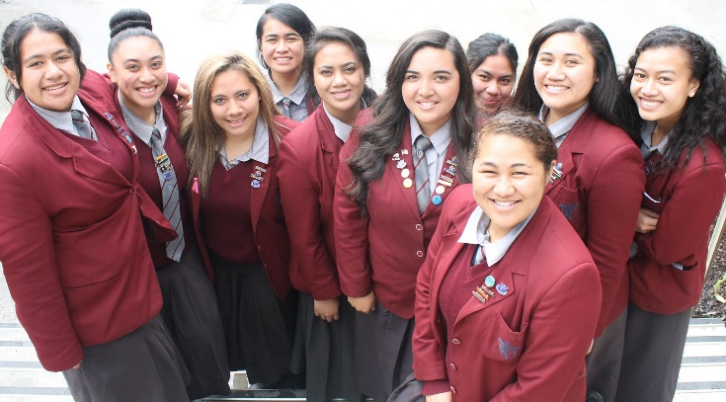
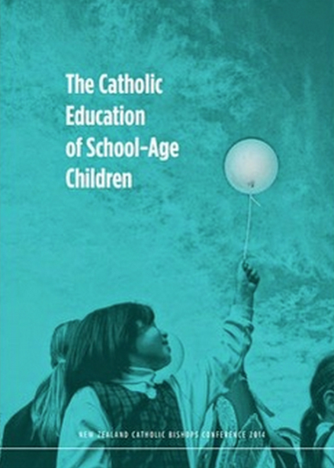
So… A reminder about the SREBD… It is
A response to the NZ Bishops “Teal document”.
A focus and discussion document to deeply
consider what is happening at ‘your place’
in terms of RE. (p. 5)
It provides guidance for teaching the current
curriculum - it is not a new curriculum itself.
It is a “bridging document” to provide support
now, and time to develop a new curriculum.
Notes:
This is a reminder from the last session 1 for the SREBD.
Again, we are introducing the idea of aiming to completely re-write the RE Curriculum, with lots of teacher involvement from all over the country, over the next 5 years or so.

Slide 14
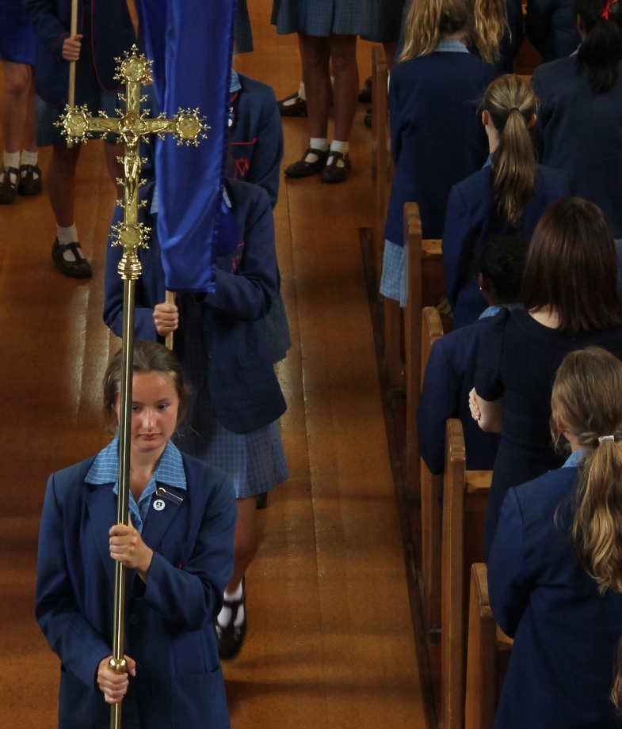
Including…
Talking and thinking about:
  Emphasis on encounter with Jesus
  Encouraging school/parish relationships
  Young people’s spirituality and holiness
  Effective assessment and evaluation
  Decisions around pedagogy
  Coverage of the Understanding Faith
  RE curriculum
Notes:
Just flick through these points – again as a reminder of what we covered in session 1.
The, lead-in to the next slide - One of the really useful aspects of this is making the AAs & AOs more accessible and trackable. And therefore able to be incorporated into RE more creatively.

Slide 15
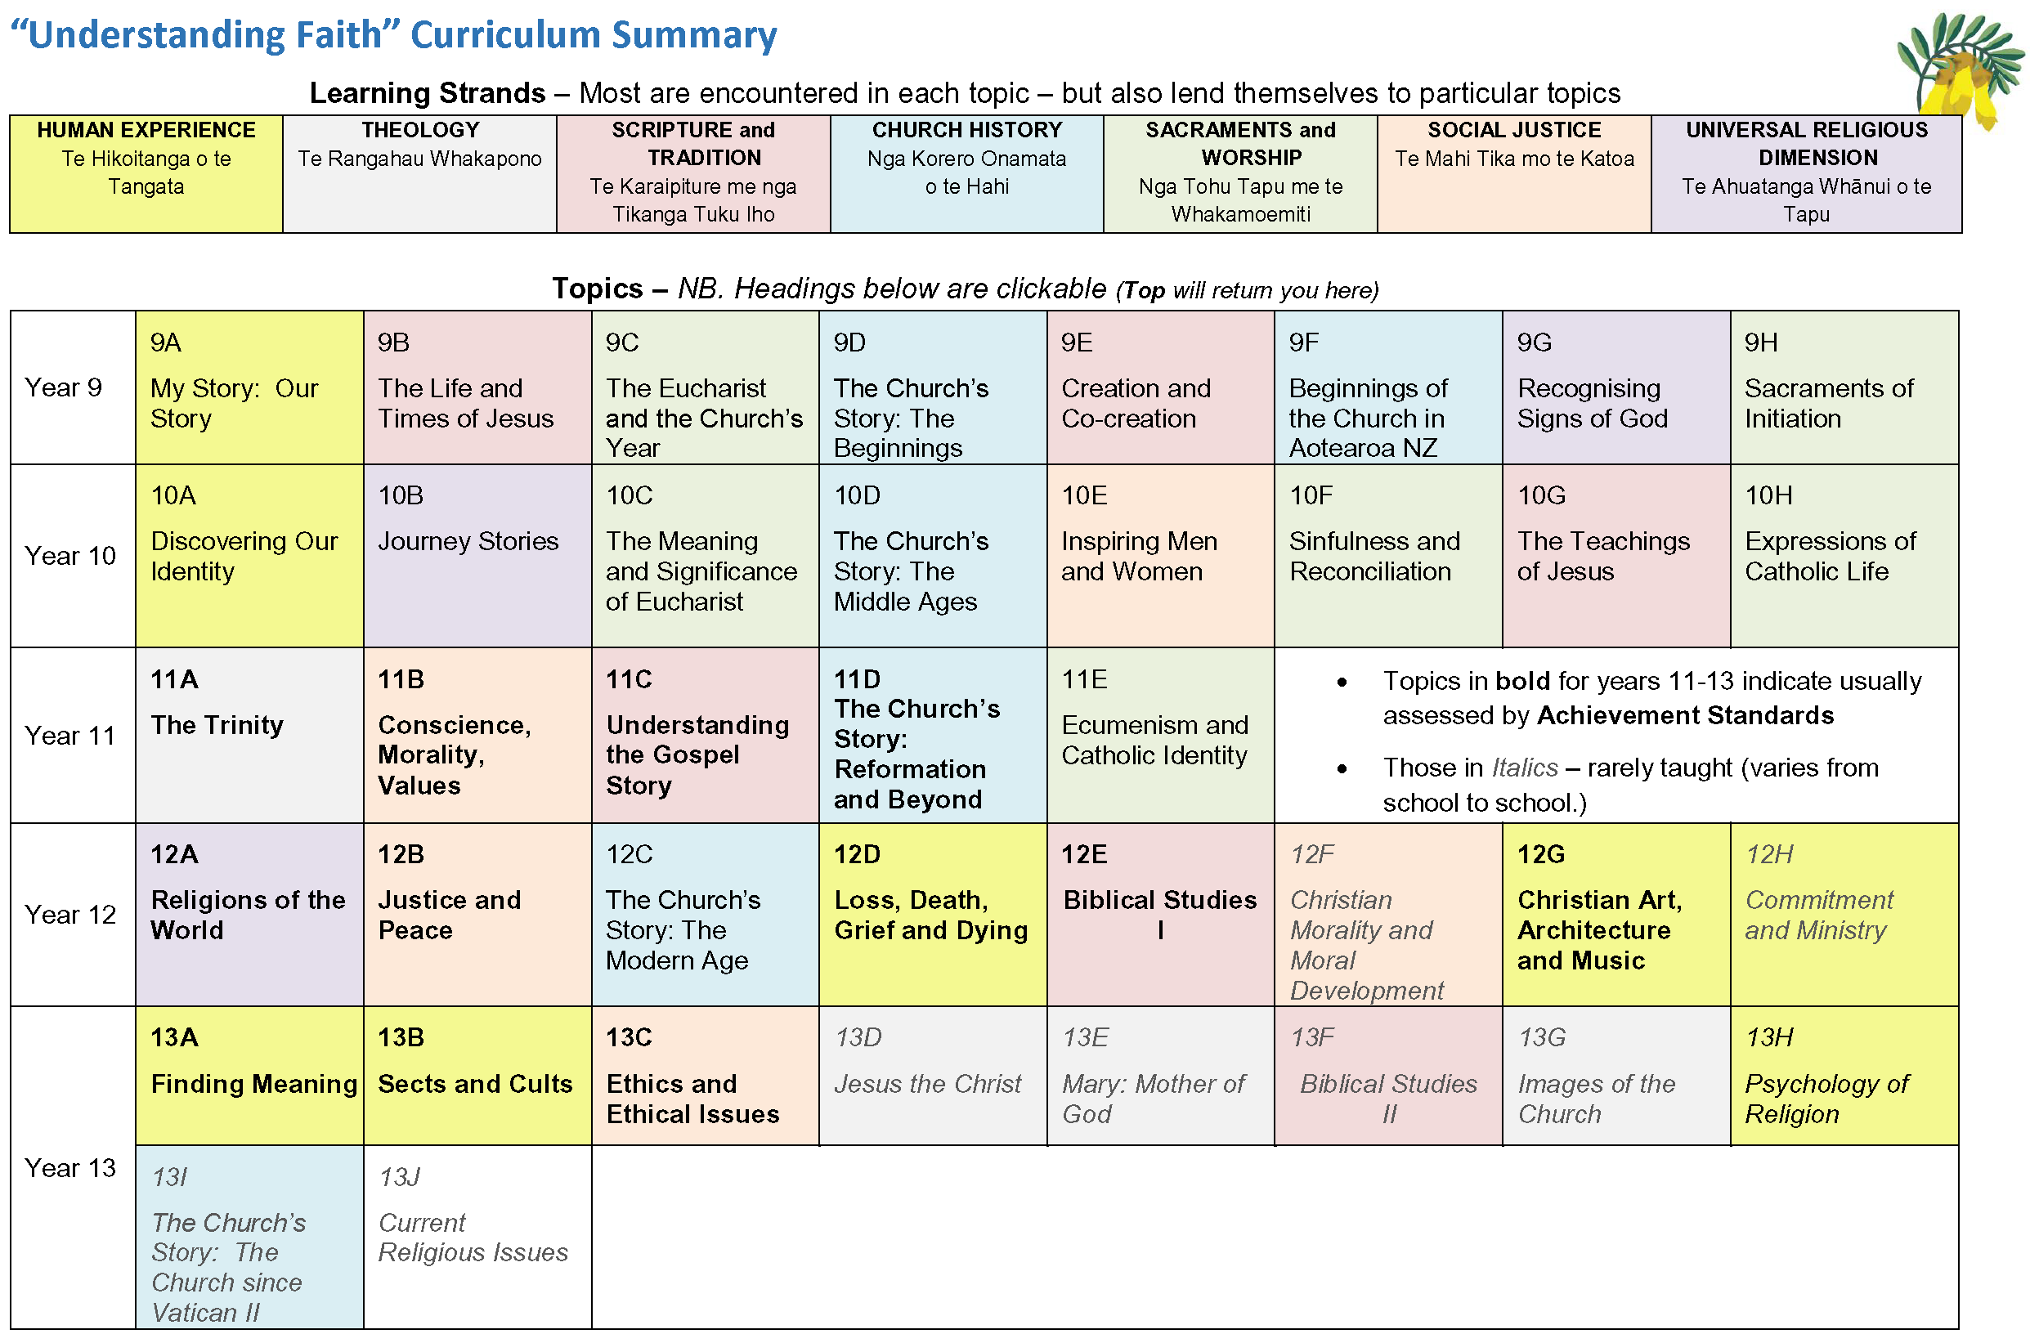
Curriculum Summary (pages 22-39)
Talk and think about:
  What topics do you actually teach at each year level?
    If you are working under the Realignment what choices have been made.
    Be particularly conscious of what is covered with Senior classes.
  What drives the decisions around this?
  How much focus is placed on:
    Achievement Aims
    Achievement Objectives
    Learning Outcomes (not listed in the SREBD)
  Where is the assessment focus? (why?)
Notes:
VERY IMPORTANT – No one is assuming staff haven’t already done this. But, we are looking at things ‘anew’. It’s a chance to step back and review what is happening. There is also no drive here for ‘change’. We’re not making work for DRSs or RE teachers. But we are wanting them to re-think what is going on at “their place”.
There is some older evidence that no school is teaching the entire UF RE curriculum.
It’s also possible that:
DRSs may have done a lot of this work but RE teachers won’t always know the thinking behind it. (Especially if there have been changes in staffing.)
If this session is run with a group of schools it’s a great chance to share what’s happening elsewhere.

Slide 16
Notes:
Comment that:
p22 is ‘clickable’ so it’s designed to be easy to get from the topics to the AAs and AOs.
The ‘strands’ were added after the programme had been written. They are a valiant attempt to create a sense of cohesion and ‘flow’ but it also doesn’t quite work. (We would aim to get this better in a new curriculum.)

Slide 17
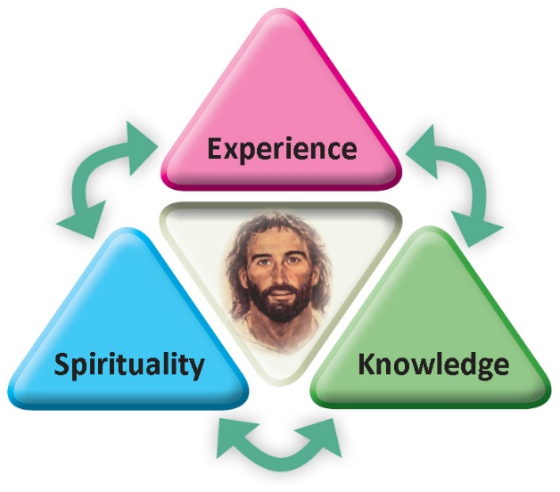
Finally, the REBD - Spirituality
2 Minutes
Staff?
Children?
What does your school do really well to nurture Spirituality?
Spirituality is the action of knowledge (Theology)
and experience coming together. (p. 7)
It is a word claimed by secular society as distinct
from Religion. But, this is far from accurate.
Spirituality in our schools is oriented towards
Jesus.
It needs to be deeply nurtured and modelled
by teachers.
Whānau?
Notes:
This is something to draw us back to the deeper aspects within the REBD. People are encouraged to read p 7 & 8 later in the week, or around a staff meeting, but they’ll be getting tired now. It’s really important to read it in a good space. ☺
Go through each of the bullet points:
The definition chosen for the SREBD isn’t ‘perfect’ but it’s an excellent touch-stone for growing understanding. What we ‘know’ and what we have ‘experienced’ forms & informs our spirituality. When the knowledge of RE meets the experience of the children it becomes internalised and part of them.
As adults, if you do a google search for ‘spirituality’ it will nearly all be non-religious! You’ll even find lists where ‘religious’ stuff is in a negative column next to ‘spirituality’ which is all positive. This is actually nonsense from a Catholic perspective. But… it’s ‘out there’ as a concept. We need to claim it back.
Again, Jesus is at the centre of our schools. There is a valid argument that this should be the triune God, and absolutely this is true. However, we need to highlight the encounter with Jesus, he’s rock-solid on which to build a personal spirituality, and also encourage encounter with the Holy Spirit and God Creator.
Young people need to be supported in their growing spirituality. And, as teachers were are constantly modelling it – whether we realise it or not. Someone once said, “You whisper what you say, and you shout who you are!” – never more true than in RE. ☺
THEN, click to reveal the discussion question. Again, there is a 2minute tracker for conversation.
Then, on the next click - feedback a bit. Ask, “Did you talk about Children or Staff?” – Why…?
Then – last click – just a thought. “What about the wider community? What does you school do that support them?” – The assumption being – probably A LOT! (But, perhaps we’re not so aware of it??)

Slide 18
Session 2 - Overview
At the end of this session, teachers will have
re-visited some understandings of
Catholic Schools,
Religious Education &
Spirituality
as woven throughout the Secondary Religious Education Bridging Document.
YES?
(Questions?)
NO?
Notes:
These are themes that flow throughout the document and which also have quite specific new direction from the previous, 20 year old, curriculum.

Slide 19

Scripture to finish with…
Something which has existed since the beginning,
that we have heard, and we have seen with our own eyes;
that we have touched with our hands:
the Word who is life - this is our subject.
What we have seen and heard we are telling you
so that you too may be in union with us, as we are in union
with the Father and with his Son Jesus Christ.
1 John 1:1,3
Notes:
This concluding scripture is from page 8 of the Understanding Faith - Religious Education Curriculum Statement.

Slide 20

Go Well, God Bless
We’d love to get some feedback:
www.tinyurl.com/rebdnz
Notes:
Just an opportunity to give some feedback – this is a link to a short Google Form. Not, compulsory. ☺

